Slide 1
Attention deficit hyperactivity disorder in institutionalized children
University of Medicine and Pharmacy Tg. Mures
Pharmacy
Author: Paul Barac-Poponut
Coordinator: conf. dr. Vari Camil

Slide 2
I. Introduction
The objective of this paper:
This paper tries to present the impact ADHD has today, the main findings in this field and the treatment possibilities considering social factors involved in institutionalization. Clinical cases are included to point out the critical elements of this disorder.

Slide 3
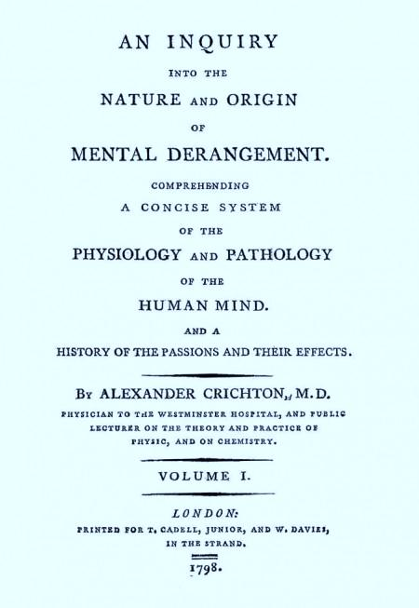
Hystory of ADHD
“In this disease of attention, if it can with propriety be called so, every impression seems to agitate the person, and gives him or her an unnatural degree of mental restlessness. People walking up and down the room, a slight noise, in the same, the mowing a, the shutting a door suddenly, a flight excess of heat or of cold, to much light or to little light, all destroy constant attention in such patients. Inasmuch as it is easily is exited by every impression.” page”272
http://adhdhistory.com/alexander-crichton/

Slide 4
II. General information. Prevelance
Attention-deficit/hyperactivity disorder (ADHD) is the most common neurobehavioral disorder of childhood and often persists into adulthood. A 2003 survey found an estimated 7.8% of children aged 4–17 years had ever been diagnosed with ADHD.
The prevalence of parent-reported ADHD among children aged 4–17 years increased 21.8% during 2003–2007, from 7.8% to 9.5%. Among older teens, the increase was 42%, and among Hispanic children the increase was 53%.

Slide 5
III. ADHD profile
Neuropsychological Functions Affected in ADHD
Attention
Alertness
Vigilance
Executive functions
Working memory
Response inhibition
Cognitive flexibility
Planning
1. Diagnosis criteria
1. Fails to give close attention to details or makes careless mistakes in schoolwork, work, or other activities
2. Has difficulty sustaining attention in tasks or play activities
3. Does not seem to listen when directly spoken to
4. Fails to follow through on instructions and fails to finish schoolwork, chores, or work duties
5. Has difficulty organizing tasks and activities
6. Avoids, dislikes, or is reluctant about engaging in tasks that require sustained mental effort
7. Loses things necessary for tasks or activities (e.g., toys, school assignments, or tools)
8. Gets easily distracted by extraneous stimuli
9. Is forgetful in daily activities
B. Hyperactivity–Impulsivity Dimension:
1. Fidgets with hands or feet or squirms in seat
2. Leaves seat in classroom or in other situations in which remaining seated is expected
3. Runs about or climbs excessively in situations in which it is inappropriate (in ado­lescents or adults, may be limited to subjective feelings of restlessness)
4. Has difficulty playing or engaging in leisure activities quietly
5. Is “on the go” or acts as if “driven by a motor”
6. Talks excessively
7. Blurts out answers before questions have been completed
8. Has difficulty awaiting turn
9. Interrupts or intrudes on others (e.g., butts into conversations or games)
A. Inattentive–Disorganized Dimension:

Slide 6
2. ADHD causes
ADHD causes
Pregnancy factors: Intrauterine growth restriction
Neurochemestry: dys­functional catecholaminergic signaling
Genetics: Polymorphisms in the neurotransmiters transporter genes
Intoxication: lead
Neurophysiology: altered cor­ticostriatal circuitry

Slide 7
IV. Treatment possibilities
When medication is indicated, XR preparations should be considered as first-line therapy for ADHD because they are more effective and less likely to be diverted. Future research and cost-benefit analyses should consider both efficacy and effectiveness, and the diversion and misuse potentials of these medications. Industry, insurance companies and government must work together to make these medications accessible to all children and youth with ADHD.
Using data from the United States Integrated Health Care Information Services administrative database, Lage and Hwang (33) showed that children who were initially treated with XR stimulant medications were less likely to switch, discontinue or have gaps in their treatment, than children prescribed IR stimulant medications.
The reasons for this included:
• improving adherence,
• reducing stigma (because the child or young person does not need to take medication at school),
• reducing problems schools have in storing and administering controlled drugs, and
• their pharmacokinetic profiles.
Amphetamine derivate –Methylphenidate
The coating mechanism of XR preparations for ADHD may make the active stimulant more difficult to extract and less likely to produce euphoria. If this is true, XR preparations should be less likely to be diverted or misused than IR preparations. Intranasal use of XR MPH to achieve a ‘high’ has been reported to be unsuccessful in case series

Slide 8
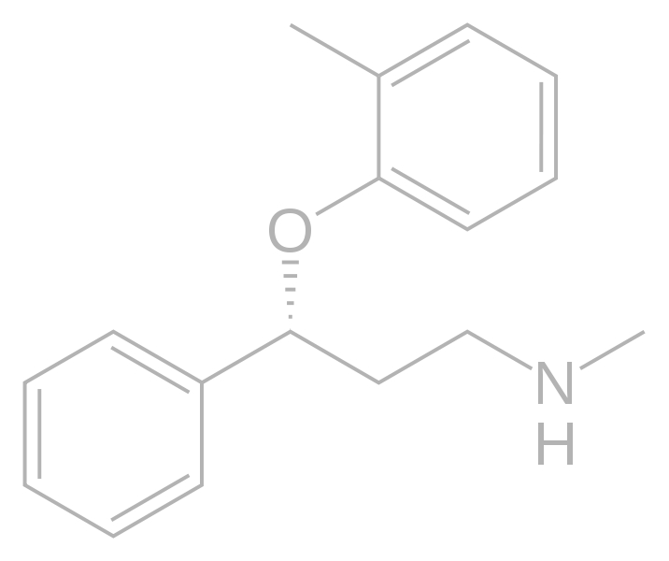
2. Drugs which interfere with SNC neurotransmission: Atomoxetine
norepinephrine reuptake inhibitor
Side effects
The side effects include, dry mouth, tiredness, irritability, nausea, decreased appetite, constipation, dizziness, sweating, dysuria, sexual problems, decreased libido, Urinary retention or hesitancy, increased obsessive behavior, weight changes, palpitations, increases in heart rate and blood pressure.

Slide 9
Other therapies
Psychotherapy
Counseling

Slide 10
Clinical case
ADHD institutionalized children

Slide 11
References
http://adhdhistory.com/alexander-crichton/
http://www.ncbi.nlm.nih.gov/pmc/articles/PMC3012665/?tool=pubmed
http://www.ncbi.nlm.nih.gov/pmc/articles/PMC3002183/?tool=pubmed
Alexander Crichton : An inquiry into the nature and origin of mental derangement : comprehending a concise system of the physiology and pathology of the human mind and a history of the passions and their effects. 1798.
-Palmer, E. D., and Finger, S. 2001. An early description of ADHD(Inattention Subtype): Dr. Alexander Crichton and the “Mental Restlessness” (1798). Child Psychology and Psychiatry Reviews, 6, 66-73.
http://www.ncbi.nlm.nih.gov/pmc/articles/PMC2806078/?tool=pubmed
http://www.ncbi.nlm.nih.gov/books/NBK44173/pdf/TOC.pdf
Vidal 2009 Le Dictionare, 85e Edition, pag. 496
http://www.cdc.gov/mmwr/preview/mmwrhtml/mm5944a3.htm
http://www.ncbi.nlm.nih.gov/pmc/articles/PMC3024724/?tool=pubmed
http://www.ncbi.nlm.nih.gov/pmc/articles/PMC3022598/?tool=pubmed

Slide 12
Thank you,

