Slide 1
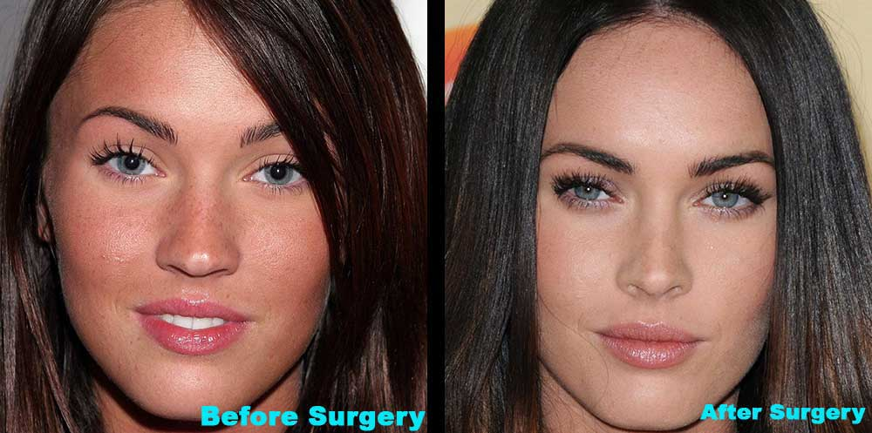
AESTHETICS - FAD OR NEED?
FIRST AUTHOR: Gînga Maria Alexandra
COORDONATOR: Șef lucrări Dr. psih. Pașca Maria Dorina

Slide 2
MOTIVATION
Dento-facial aesthetics has developed during the last few years, being in strong correlation with the need of feeling ourselves attractive, young, active participants of the society.
The concept of ‘beauty’ has varied according to the epochs and culture: until the 19th century, beauty was based on the simetry of mathematically calculated forms, such as: The Fibonacci Number, The Gold Proportion.
In comparison, the 21st century has focused on the stereotypes of the mass-media, being caracterized by the search for ‘interesting’ beauty.
The elements of an aesthetic composition are charactized by asymmetry, but it must offer balance and harmony, creating the delusion of beauty , the proportion between different elements of the face.
All these greatly influence the human mind when it comes to beauty.

Slide 3
THE AIM OF THE STUDY
Our main purpose is to show if the surgical procedure regarding dento-facial aesthetics is a fad or need, starting with premise that beauty is subjective, it depends on human perception.
What we see is determined by what we espect to see, by preconceptions and prejudice.

Slide 4
OBJECTIVES
1.to make a difference between fad and need, concerning surgical interventions
2.to know the positive, or especially the negative aspects implied by a surgical procedure
3.to take the risk of a physical change with all the psyche-social implications of it, thus preventing some kind of attitude and behavioral disorders
4.to demonstrate the need of an aesthetic intervention in case of an accident or morphofunctional disorder
5.to outline the aesthetic of beauty as an element of moral integrity and not as a way of being part of the community

Slide 5
MATERIALS AND METHODS
Questionnaire= a series of questions asked in a certain way in order to make an investigation
Observation= the procedure of scientific knowledge that consists of methodically and knowingly contemplate a process
Those questioned were in number of 80 people, 20 male and 60 female, aged between 20-30 years, with different social and educational status.
SAMPLING CRITERIA
80 people-60 female
-20 male

Slide 6
QUESTIONNAIRE
1. Do you believe in ideal beauty?
⃝ YES ⃝ NO ⃝I DO NOT KNOW ⃝ I DO NOT CARE
2.Do you think that ideal beauty can be categorized in certain parametres, can be calculated, measured?
⃝ YES ⃝ NO ⃝I DO NOT KNOW ⃝ I DO NOT CARE
3. Is it important for you to look good?
⃝ YES ⃝ NO ⃝I DO NOT KNOW ⃝ I DO NOT CARE
If so, what kind of sacrifices would you willingly make?(motivate it):
4. Would you accept a surgical procedure?
⃝ YES ⃝ NO ⃝I DO NOT KNOW ⃝ I DO NOT CARE
If so, why? (motivate it):
5.What kind of benefits would the new look bring?

Slide 7
QUESTIONNAIRE
6.Are you ready to face a failure or a painful treatment caused by the complications that may occur?
⃝ YES ⃝ NO ⃝I DO NOT KNOW ⃝ I DO NOT CARE
7. In what situation do you think that a surgical procedure is a fad? (give arguments):
8. If in case of a disease or an accident , you needed a surgical procedure, would you accept it no matter what kind of risks it may imply?
⃝ YES ⃝ NO ⃝I DO NOT KNOW ⃝ I DO NOT CARE
9. If the surgical procedure put your health in danger, would you accept to do it only for aesthetical reasons?
⃝ YES ⃝ NO ⃝I DO NOT KNOW ⃝ I DO NOT CARE
10. If in case of a disease you had to make a traumatizing/mutilating surgical intervention, , would you accept to do it to the detriment of beauty?
⃝ YES ⃝ NO ⃝I DO NOT KNOW ⃝ I DO NOT CARE

Slide 8
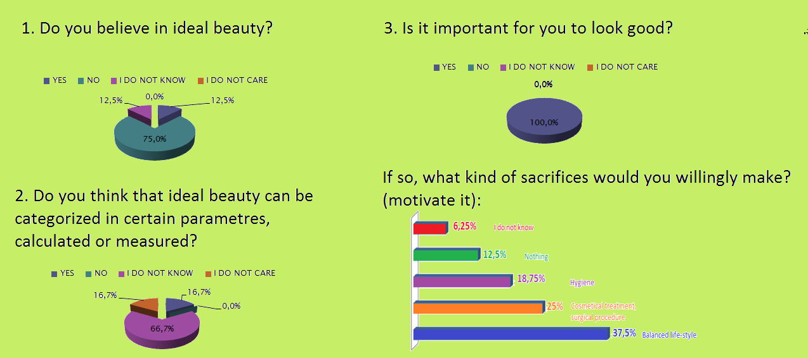
THE INTERPRETATION OF THE QUESTIONNAIRE

Slide 9
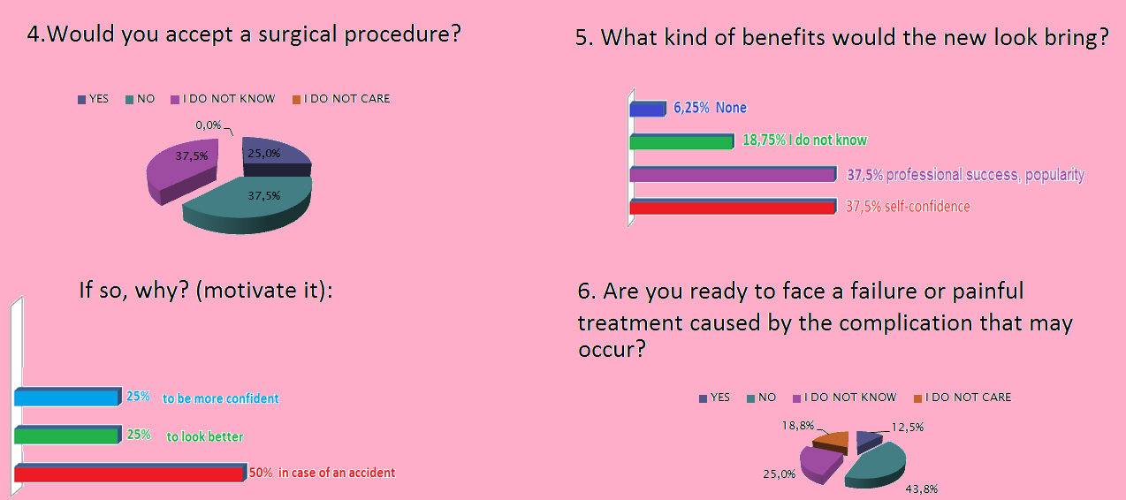

Slide 11
RESULTS
After the interpretation of the answers given in the questionnaires, we noticed that there is a difference of opinion regarding the meaning of fad and need.
Most of the people agreed upon the fact that they would only accept a surgical procedure if they suffered from morphological disorder.
Only a few of the people asked would consider taking the risks of a procedure to be more fashionable.

Slide 12
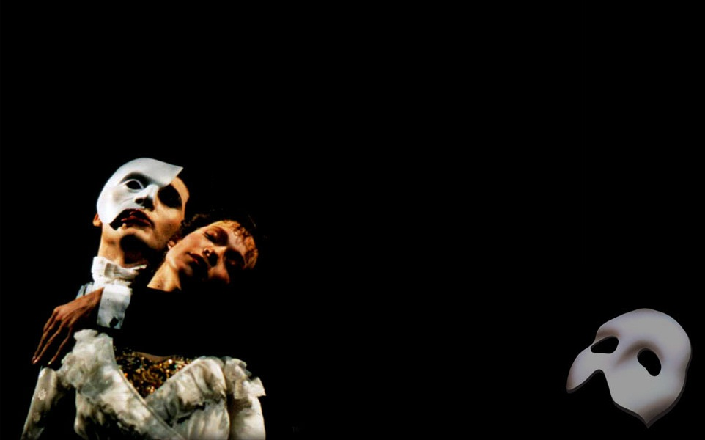
CONCLUSION
-it is important to make the involved person accountable for the surgical intervention
-to raise awareness of the psycho-social impact of the procedure on one’s personality
-the implication of the bio-psycho-social factors in the resizement of the concept of ‘aesthetics’ regarding fad or need.

Slide 13
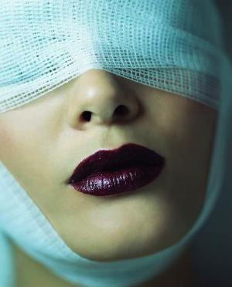
BIBLIOGRAPHY
Horga C.,Pacurar M.,Markovicz E.(2008) Dentogenia si estetica faciala
Pasca M. D.(2007) Consilierea psihologica in mediul universitar,Ed.University Press,Tg.Mures
Pasca M.D.(2008) Povestea terapeutica,Ed.V&I Integral Buc.
http://abstract.desktopnexus.com
www.plasticsurgerymarketing.com
pink-mania.info

Slide 14
THANK YOU!

