Slide 1
SPECIFIC ASPECTS OF THE EVOLUTION AND PROGNOSIS OF RHEUMATOID ARTRITIS
FIRST AUTHOR: OPRIȘ IULIA-CRISTINA
AUTHOR: ANGHEL (BUJOR) VALENTINA
COORDINATOR: Prof. Dr. GEORGESCU LIA,
Dr. SZASZ SIMONA

Slide 2
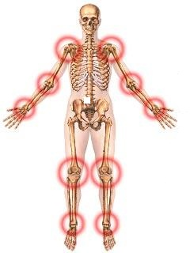
INTRODUCTION
-systemic autoimmune disease→ chronic evolution
-unknown etiology
-produce an inflammatory response
-afffect –joints cartilage
-epiphyses
-ligaments
-tendons
-causes - pain,
- swelling,
- stiffness
-loss of function

Slide 3
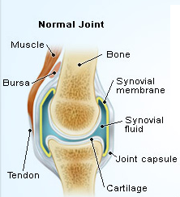
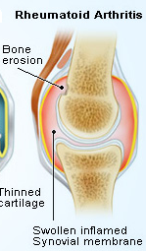
OBJECTIVE AND METHODS
In the Rheumatology Clinic of Targu Mures
Follow: - the evolution
-the prognosis
A -retrospective
-observational
-analytical study
On a number of 100 patients - 85 woman
- 15 men

Slide 4
The evolution and the prognosis according to : 1 sex
2 age
increased disease prevalence in patients aged over 60 years is explained by the fact that this disease started with 10 to 15 years before carrying out this study
-common in woman with a privalence of 4-5:1

Slide 5
3 According to the environment
-the patients form the rural areas
- lower access to health services
-distrust of pharmacotherapy provided by hospitals
-lower awareness of the disease

Slide 6
Analyzing the age when the first symptoms appeared and when they were diagnosed
- woman - men
↓ ↓
2,2 years 0,8 years

Slide 7
Analyzing the differences between the first symptoms and the age of diagnosis
p=0,0024
-from15 patients :
-14 (93,33%) early diagnosis (0-1 year)
-1 patient (6,67%) over this period
-from 85 patients :
-45 (52,94%) early diagnosis
- 40 (47,06%) over 1 year

Slide 8
3 The association between a delayed diagnosis and the social environment of female patients
-from 39 pratients from the rural areas
-12 patients(30,76%)-early diagnisis (< 1 year)
-27 patients 69,24%) over this period.
-from 46 patients from the urban area
-35 (76,08%)- early diagnosis (<1year)
-11 (23,92%) over this period

Slide 9
4.The association between a delayed diagnosis and the social enronment of male patients
This difference was not noticed to the male patients

Slide 10
5.The association between a delayed diagnosis and the evolution of the disease
Studying the relationship between delay in diagnosis and the anatomical stage, statistics obtained a p value=0,0035

Slide 11
The distribution of the pacients depending the rheumatoid factor presence or absence
-The rheumatoid factor was positive at
- 76 (89,41%) woman - 11 (73,33%) men

Slide 12
Staging of patients in the study
-anatomical stage I și II -26 ( 30,58%) woman
-4 ( 26,66%) mal
-anatomical stage III-IV - 59 (69,41%) woman
-11 (73,34%) men

Slide 13
CONCLUSIONS
The prevalence of the disease is higher in females than males
The incidence of rheumatoid arthritis in rural versus urban areas is similar
The time interval between symptom onset and diagnosis is higher in women (2.2 years)
Early diagnosis of rheumatoid arthritis is associated with a less aggressive evolution both anatomically and clinically.

Slide 14
Thank you!

