Slide 1
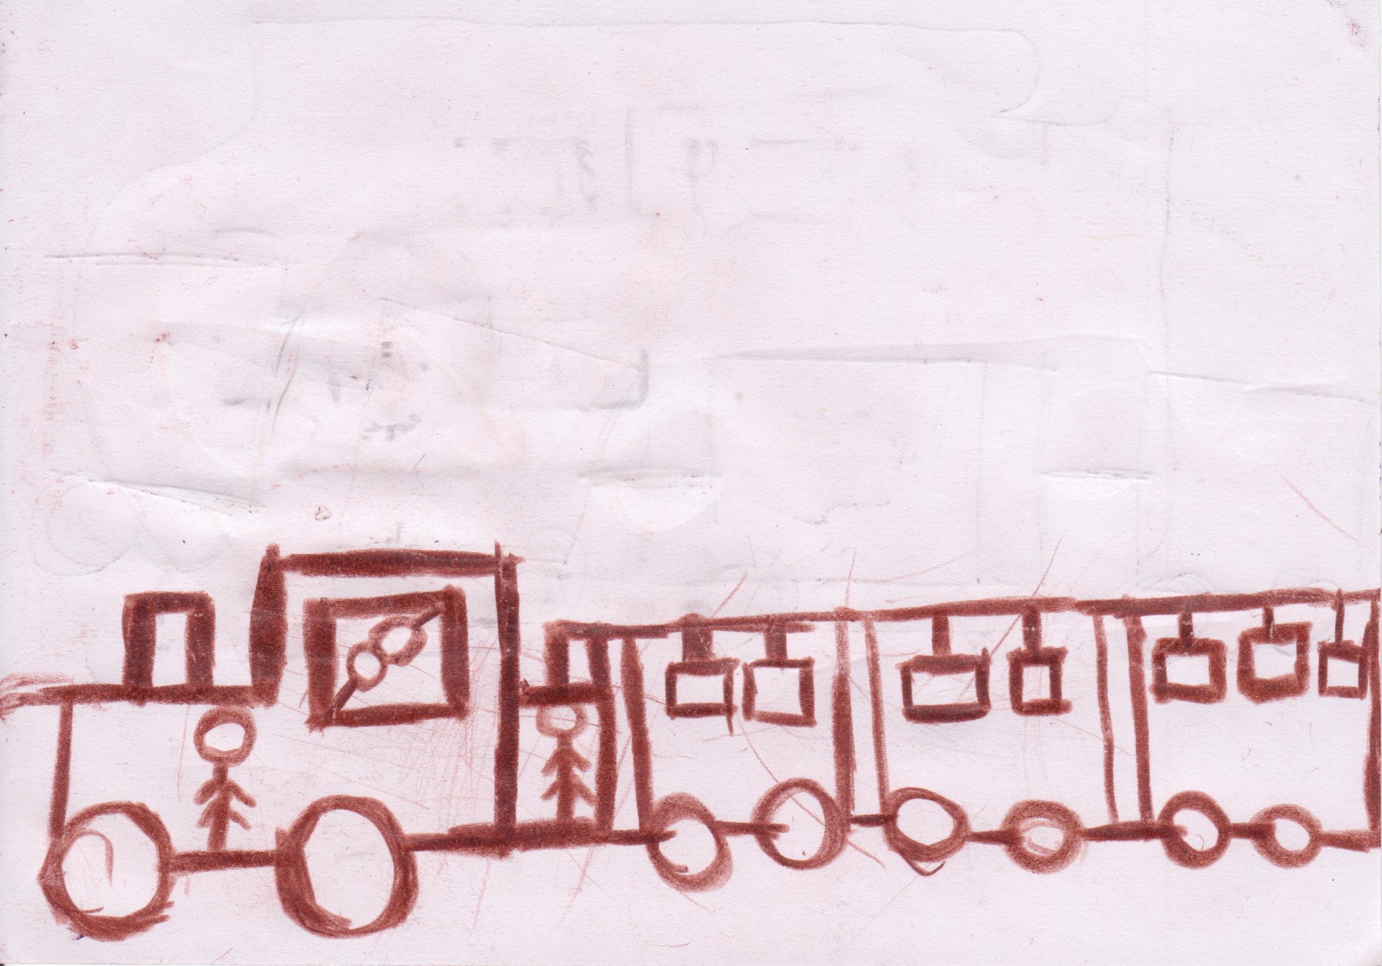
Autistic disorders in institutionalised children
University of Medicine and Pharmacy Tg. Mures
Pharmacy
Author: Paul Barac-Poponut
Coordinator: conf. dr. Vari Camil

Slide 2
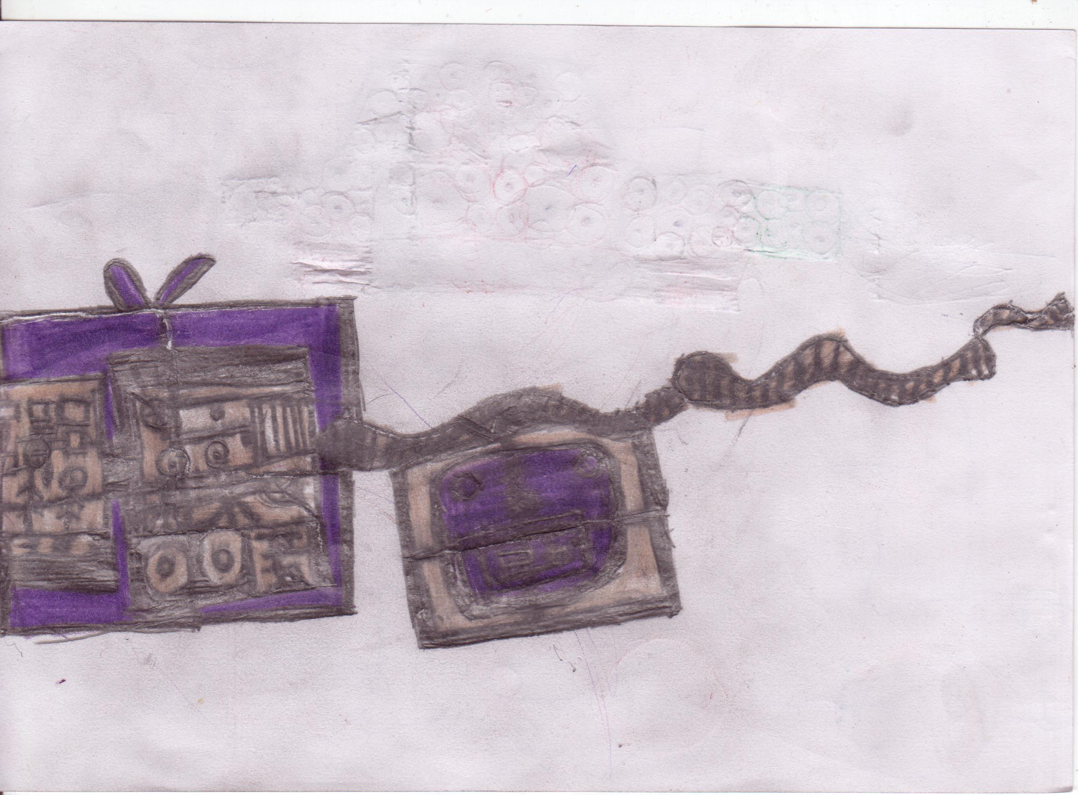
I. Introduction
The objective of this paper
The present paper tries to compile information about the autistic profiles with the clinical diagnosis elements, their available treatments and the therapy issues encountered in the case of institutionalised children.

Slide 3
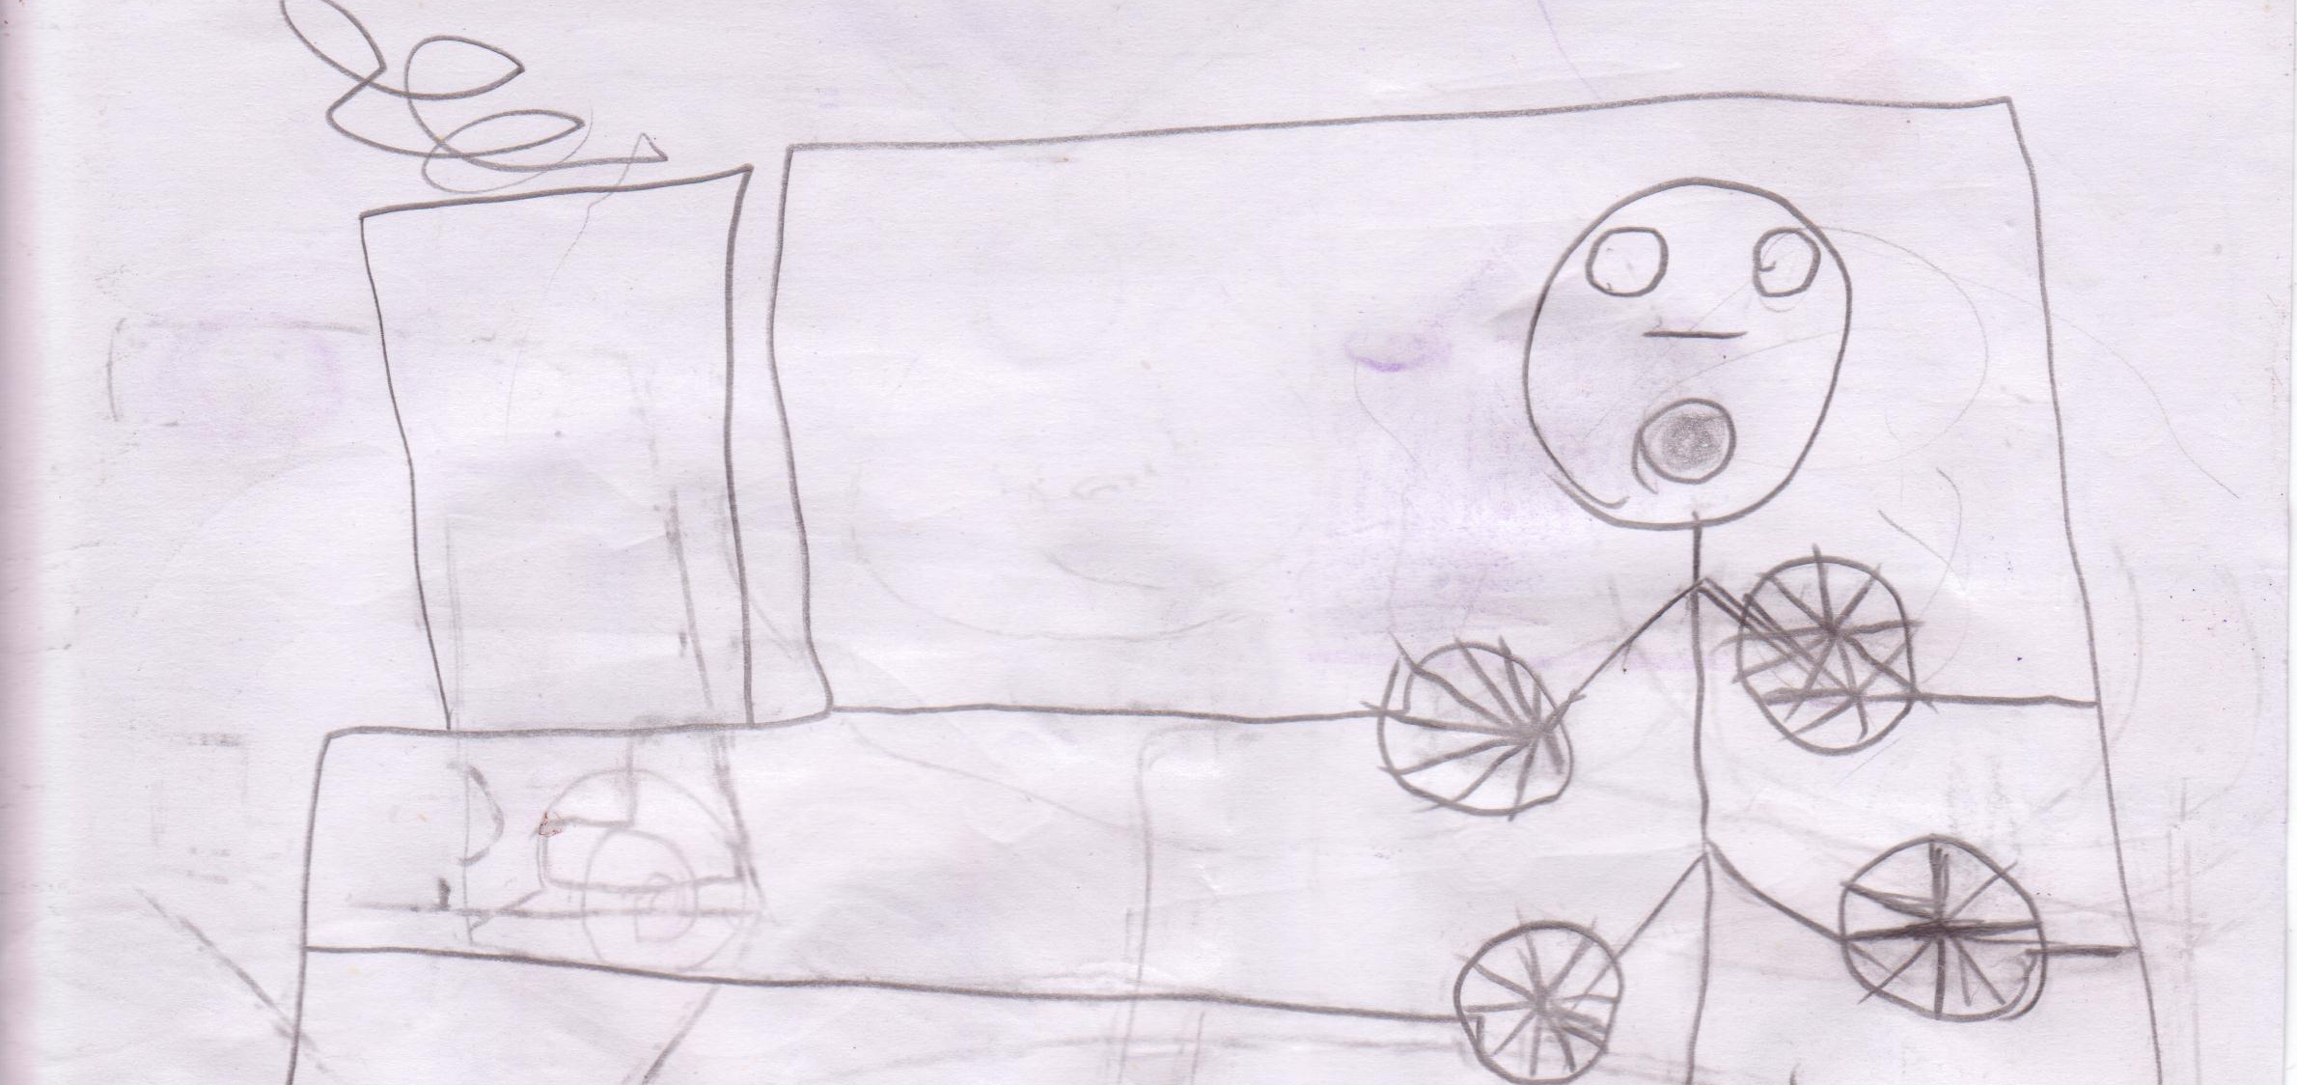
Hystory of Autism
1911-Eugen Bleuler -Swiss psychiatrist -term applied to adult schizophrenia.
In 1943 Dr. Leo Kanner of Johns Hopkins University described autism for the first time.
11 children observed between 1938 and 1943
During the 1940's through the 60's the medical community felt that children who had autism where schizophrenic. This lack of understanding of the disorder lead many parents to believe that they were at fault
During the 1960's people began to understand autism and more precisely identify autism symptoms and treatments.

Slide 4
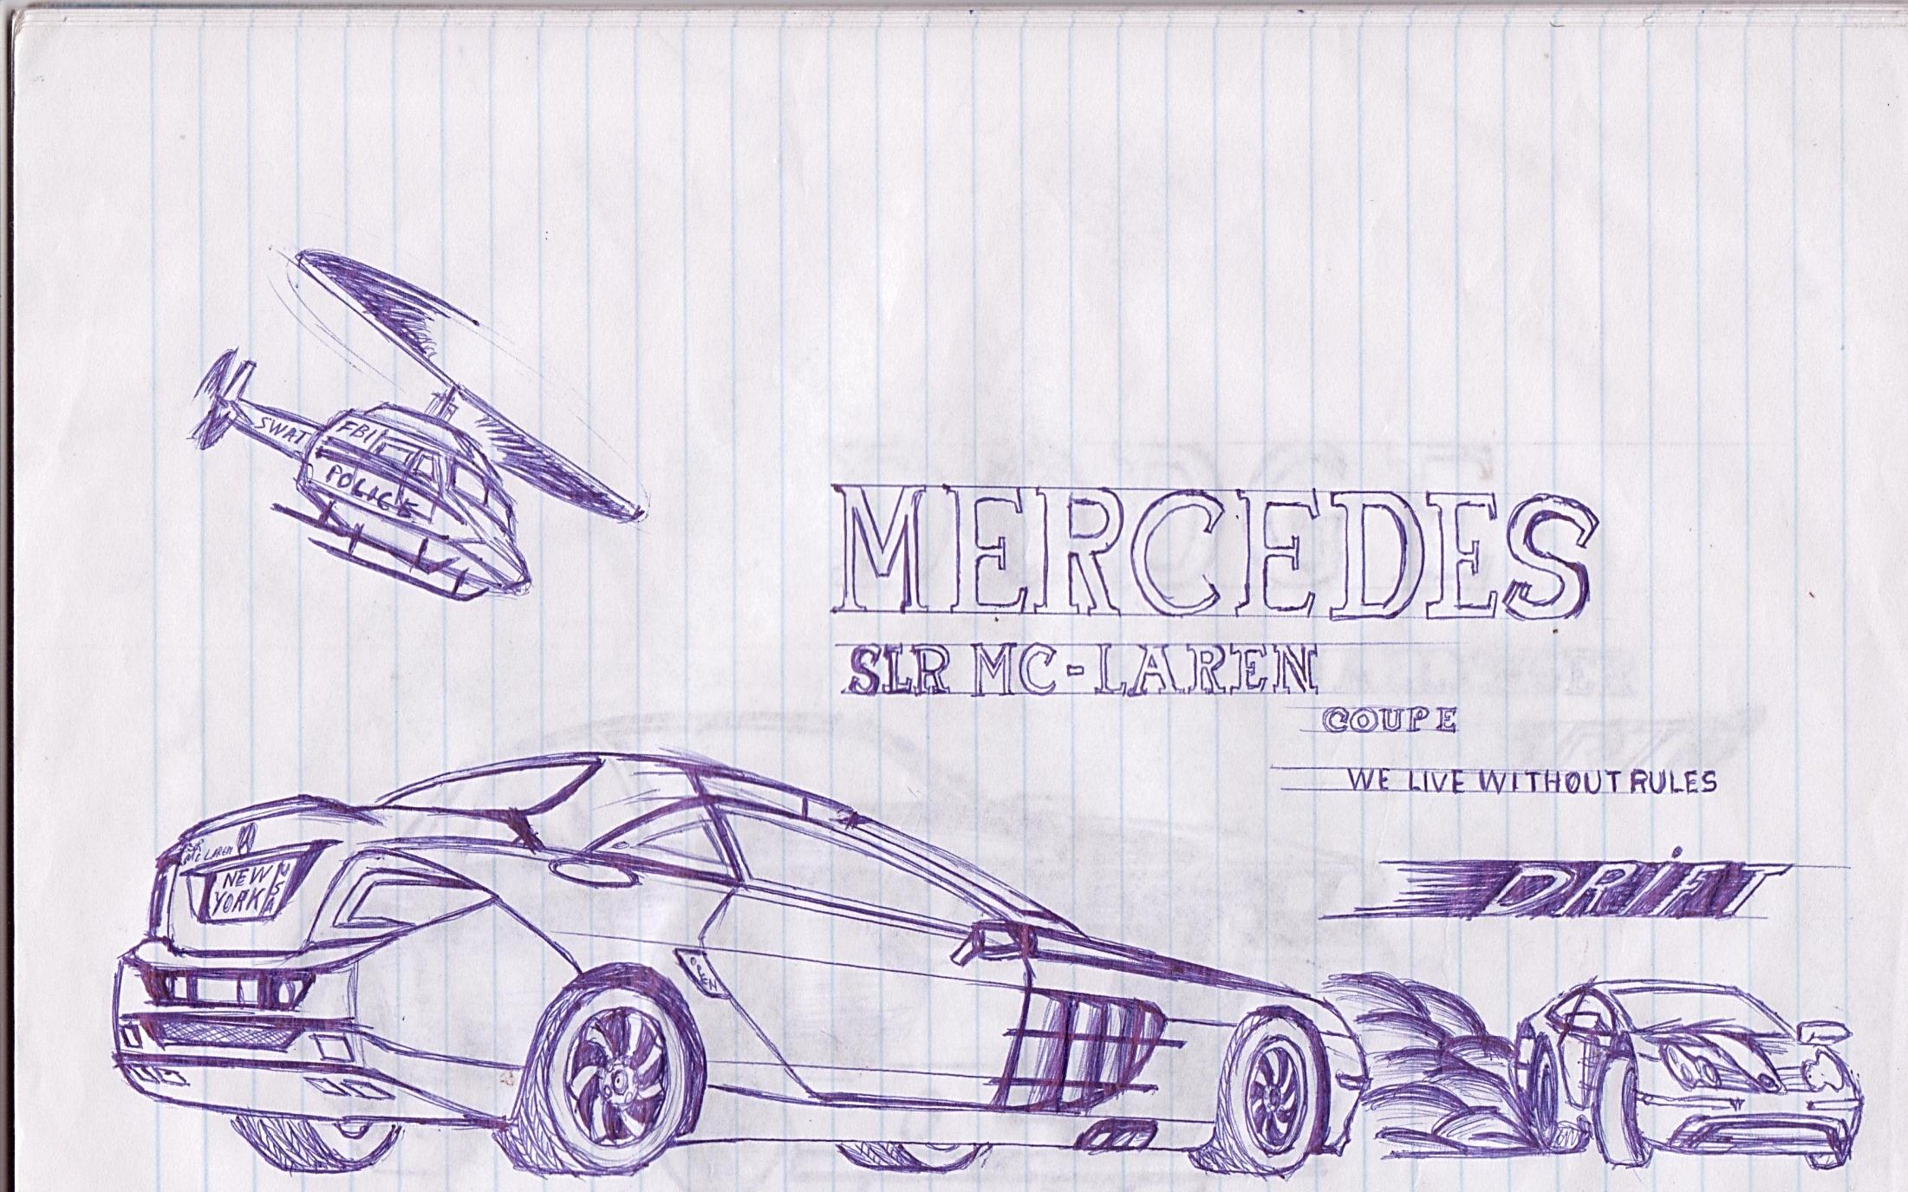
II. General information. Prevelance
A form of child schizophrenia
Autism is a neurobiologic disorder with a strong genetic factor and possibly some biologic markers involving brain structure and brain function. Universally, there is a considerable discrepancy between a person’s cognitive potential (ie, IQ) and their ability to meet the demands of everyday life (or adaptive skills). A similar condition described in this work is the Asperger syndrome, classified as one of the Autistic spectrum disorders.

Slide 5
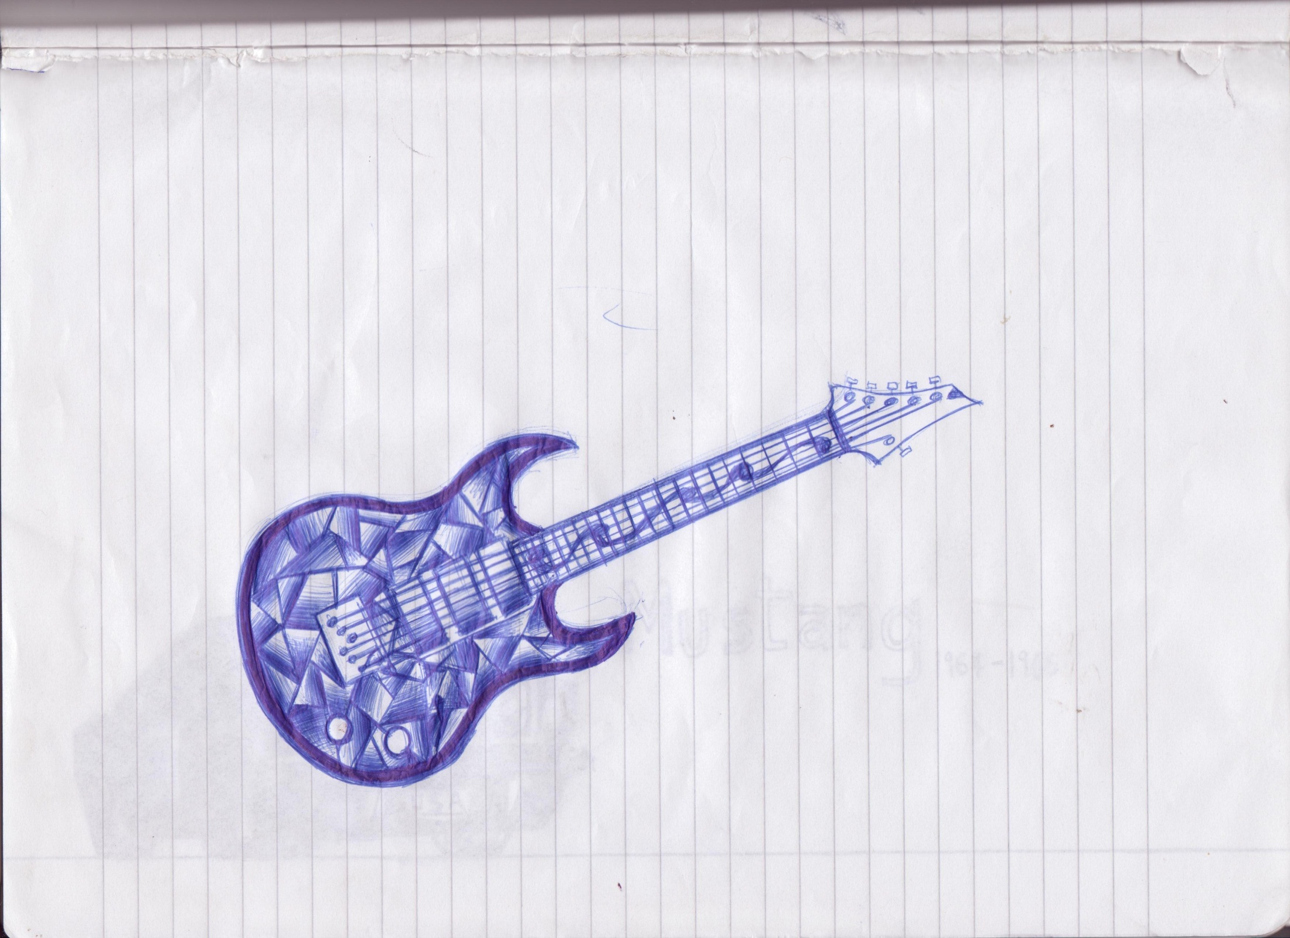
III. Autism profile
1. Diagnosis criteria
The diagnosis is entirely behavioral and it is made through clinical examination of a child’s history and current presentation in the areas of social, communicative, and play/imagination behaviors.

Slide 6
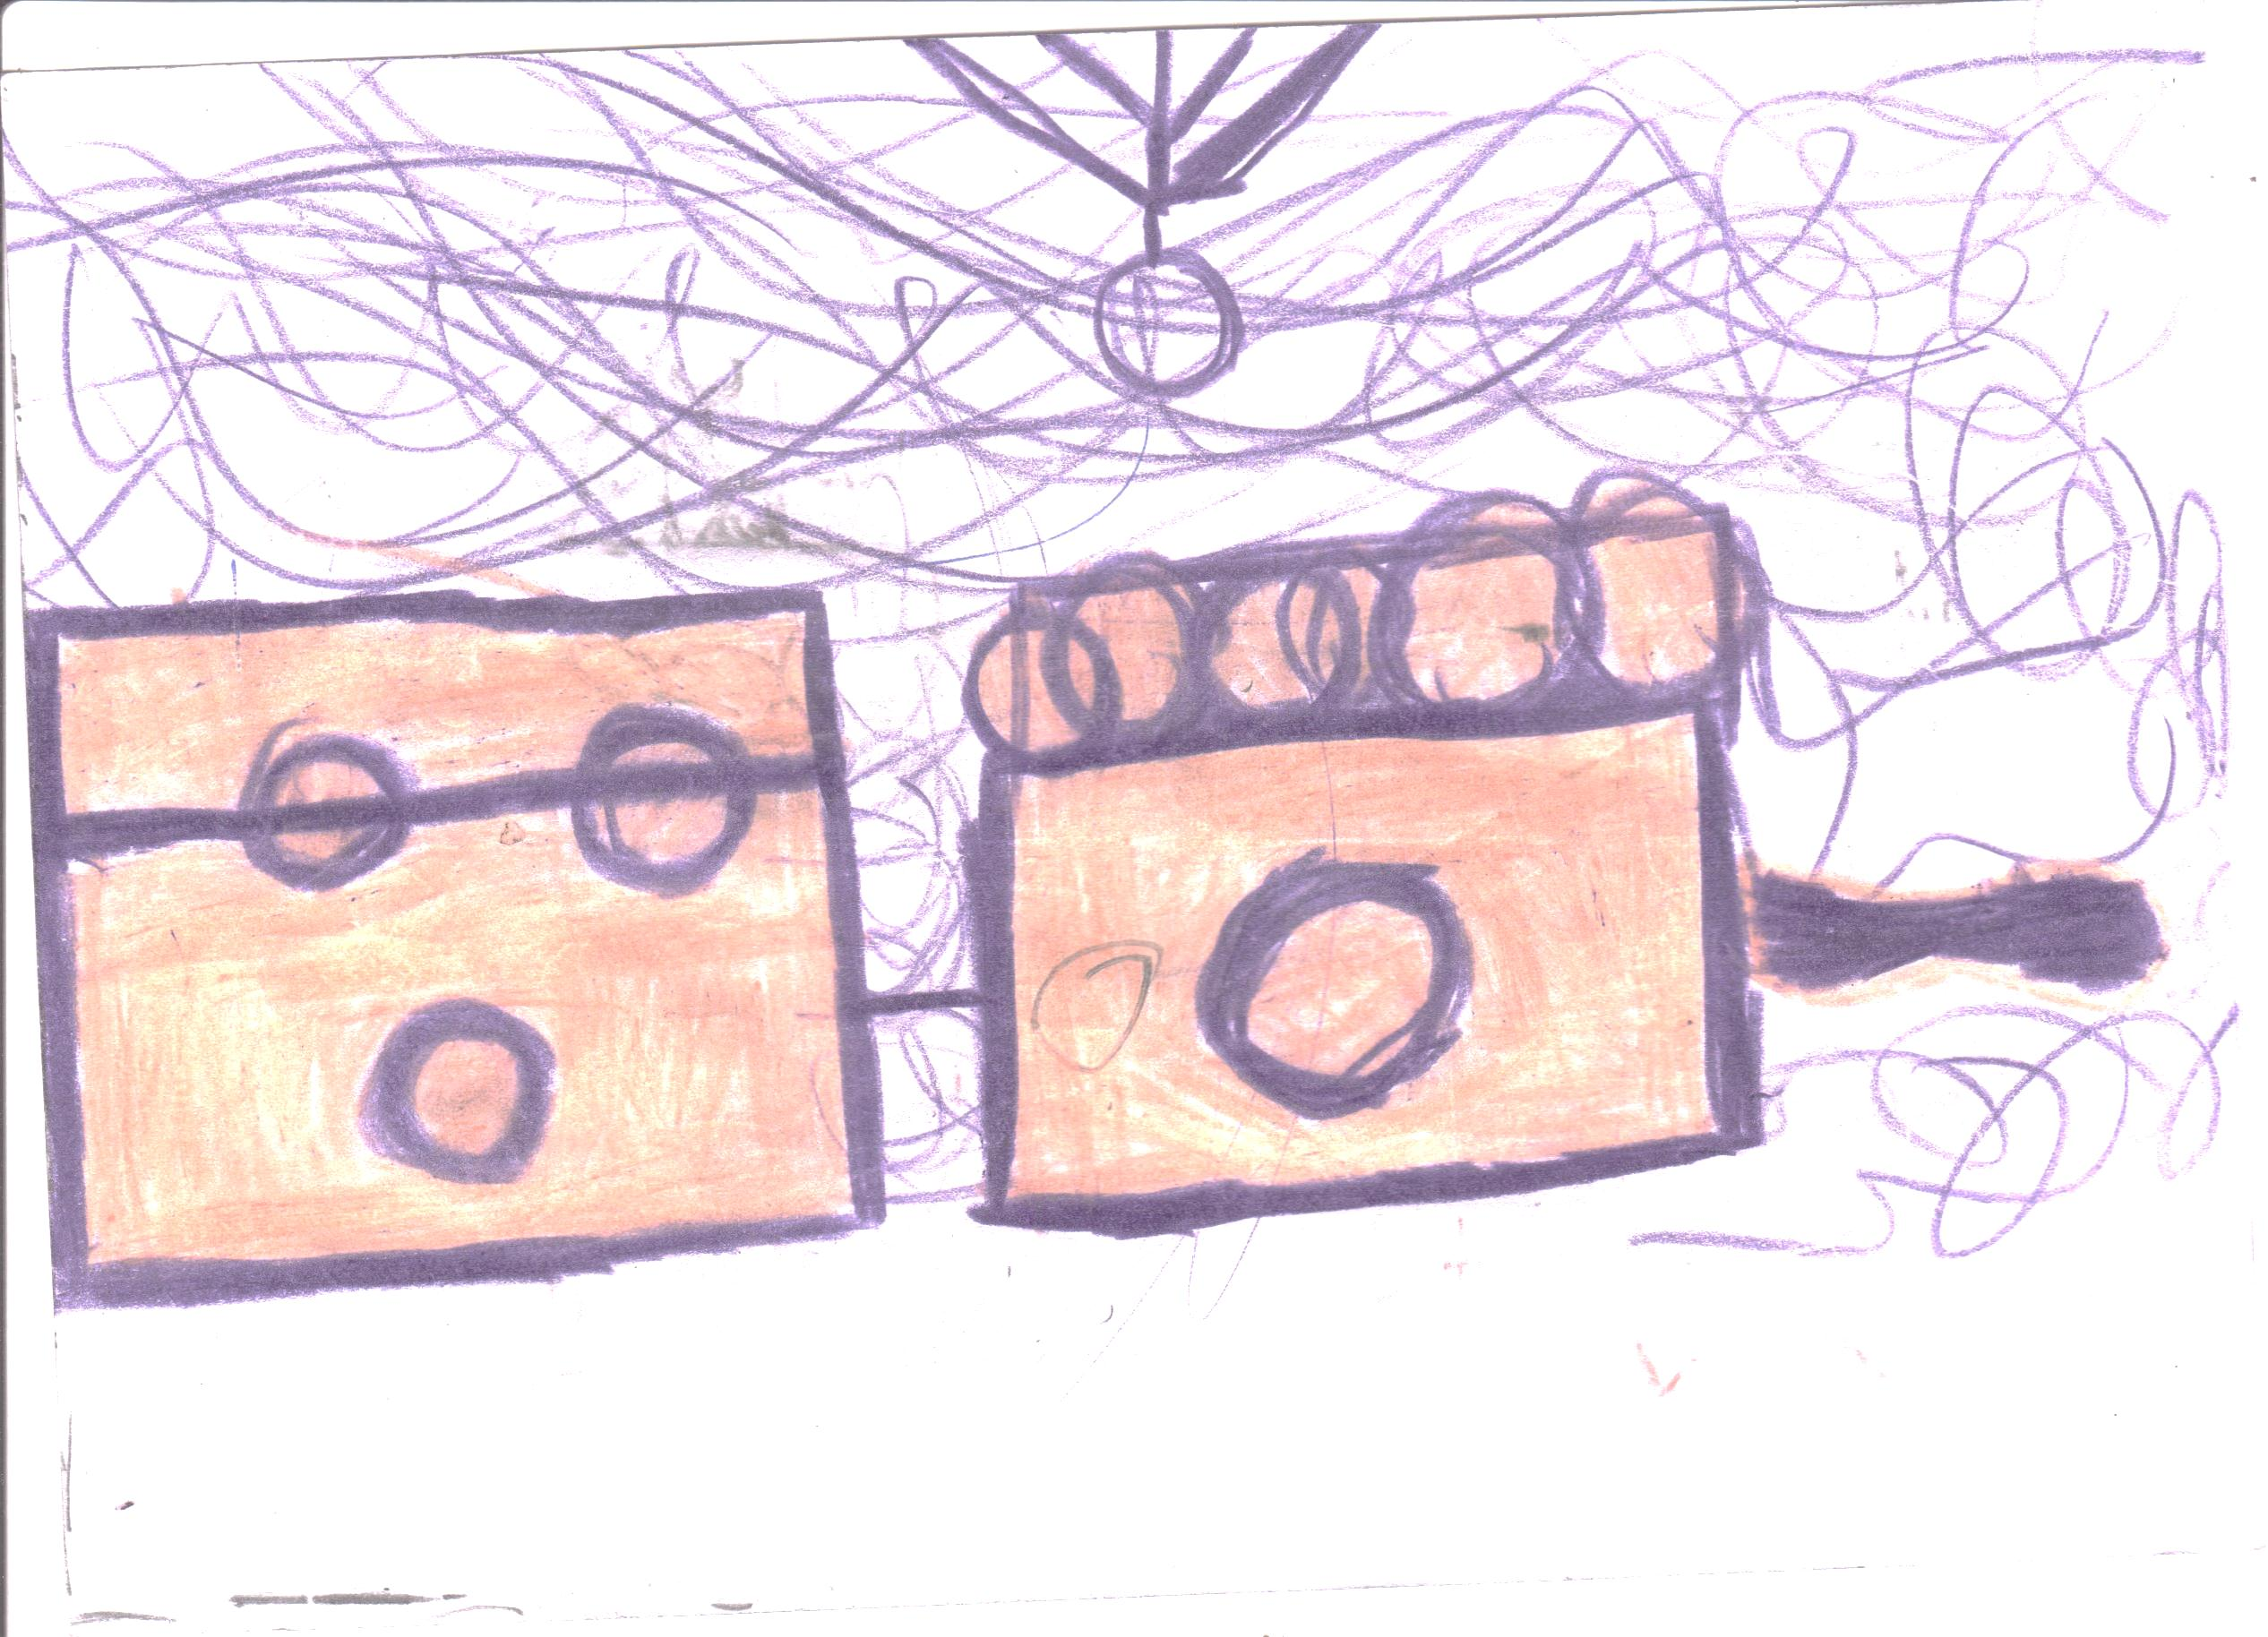
IV. Treatment possibilities
1. Antipsychotic medications active on “negative” symptoms of schizophrenia

Slide 7
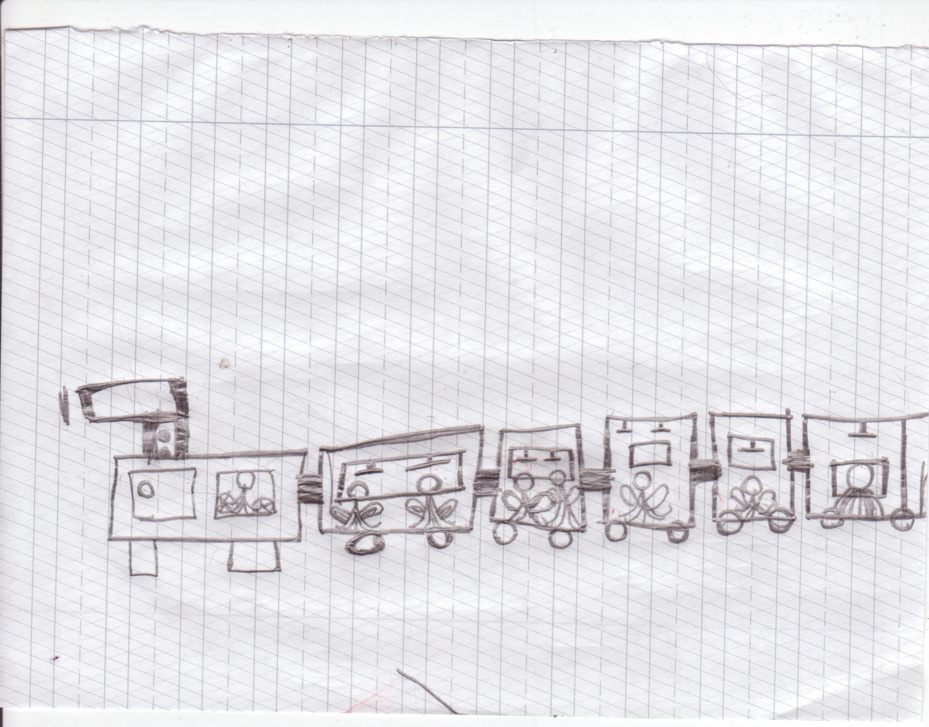
2. Auxiliary non-pharmacological methods of treatment-psychological therapies

Slide 8
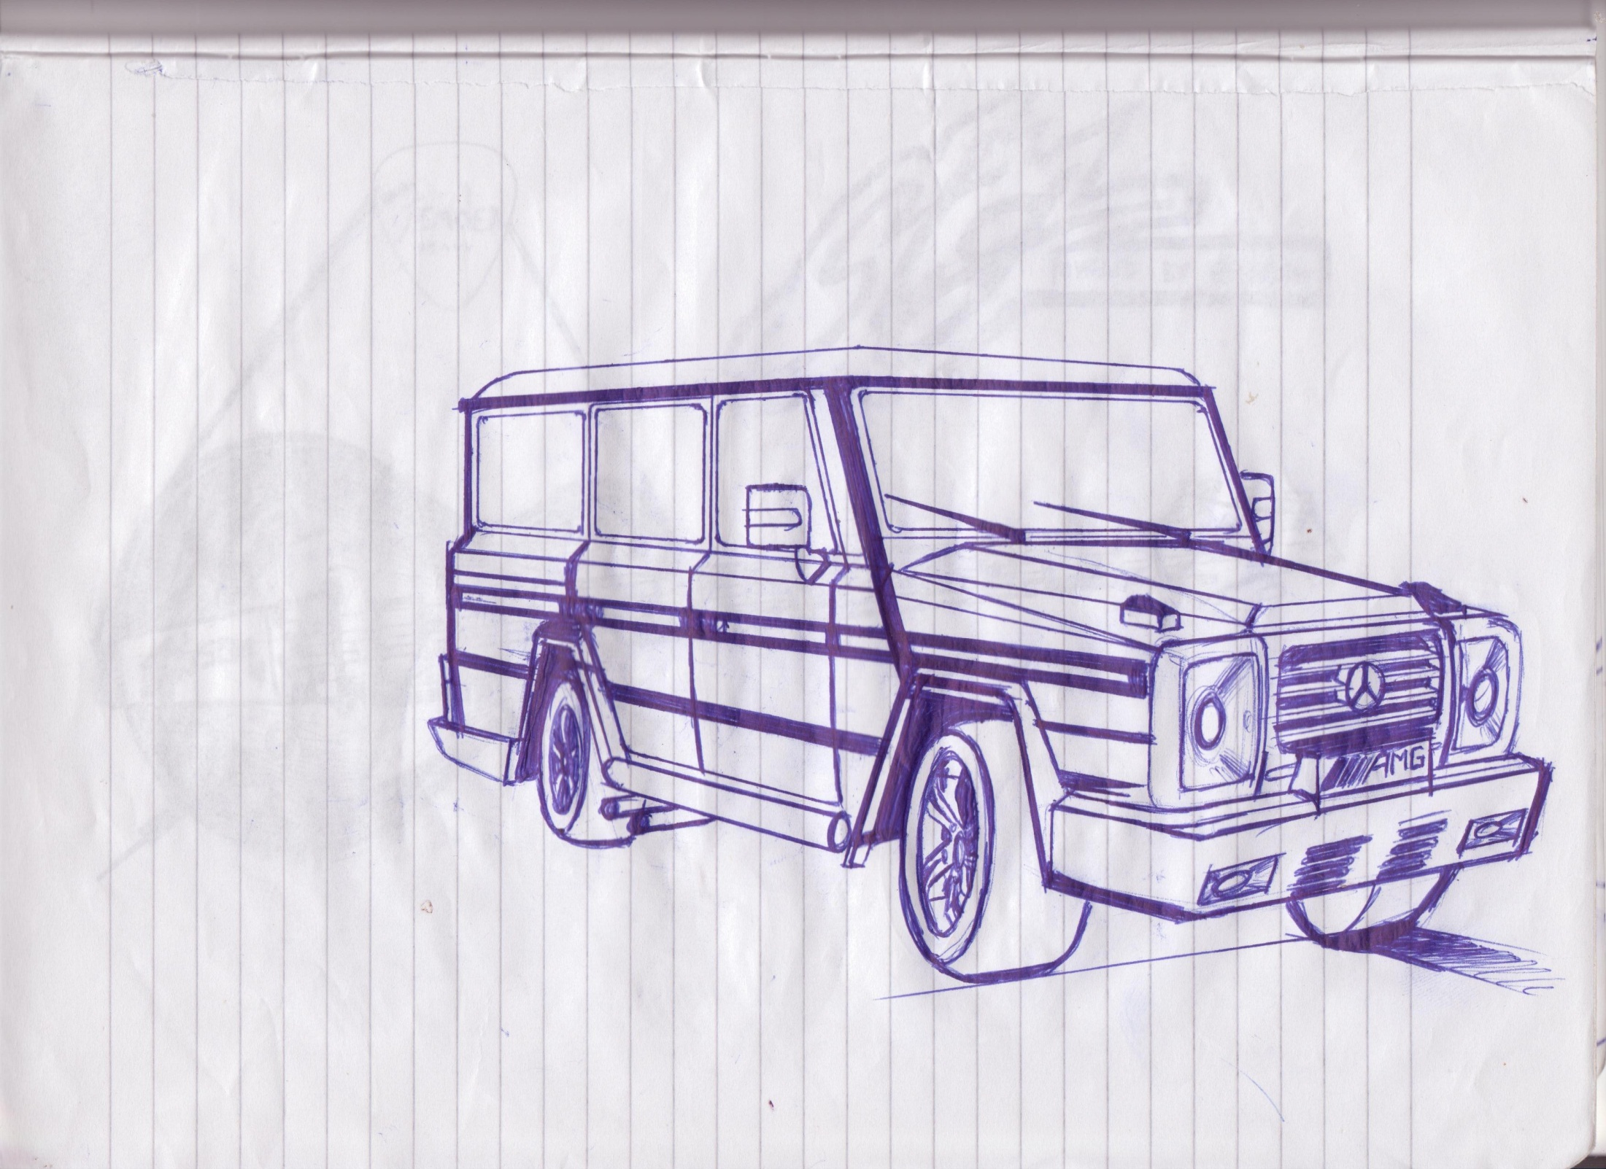
Clinical case
Autism disorders institutionalized children

Slide 9
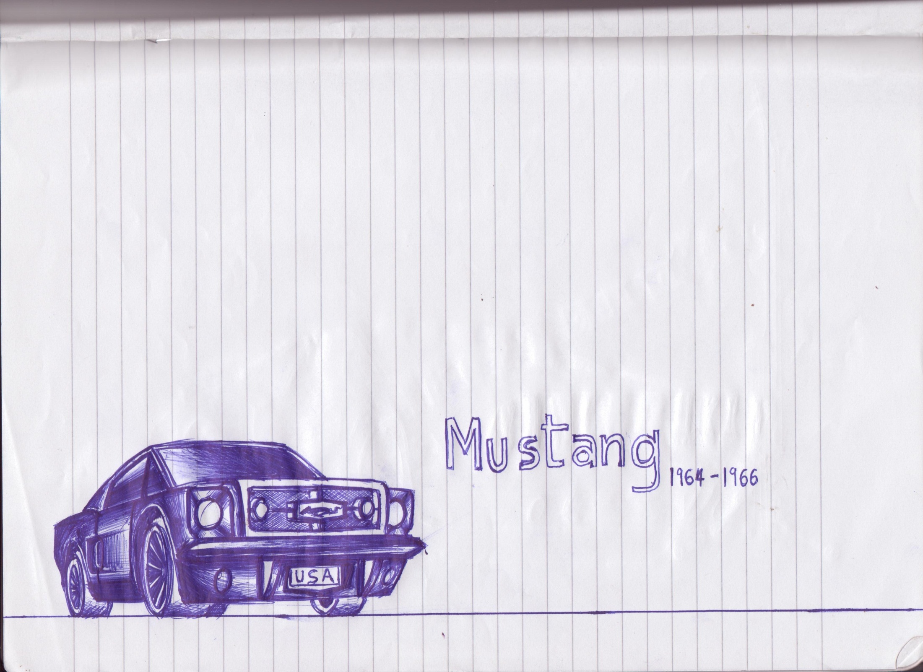
References

Slide 10
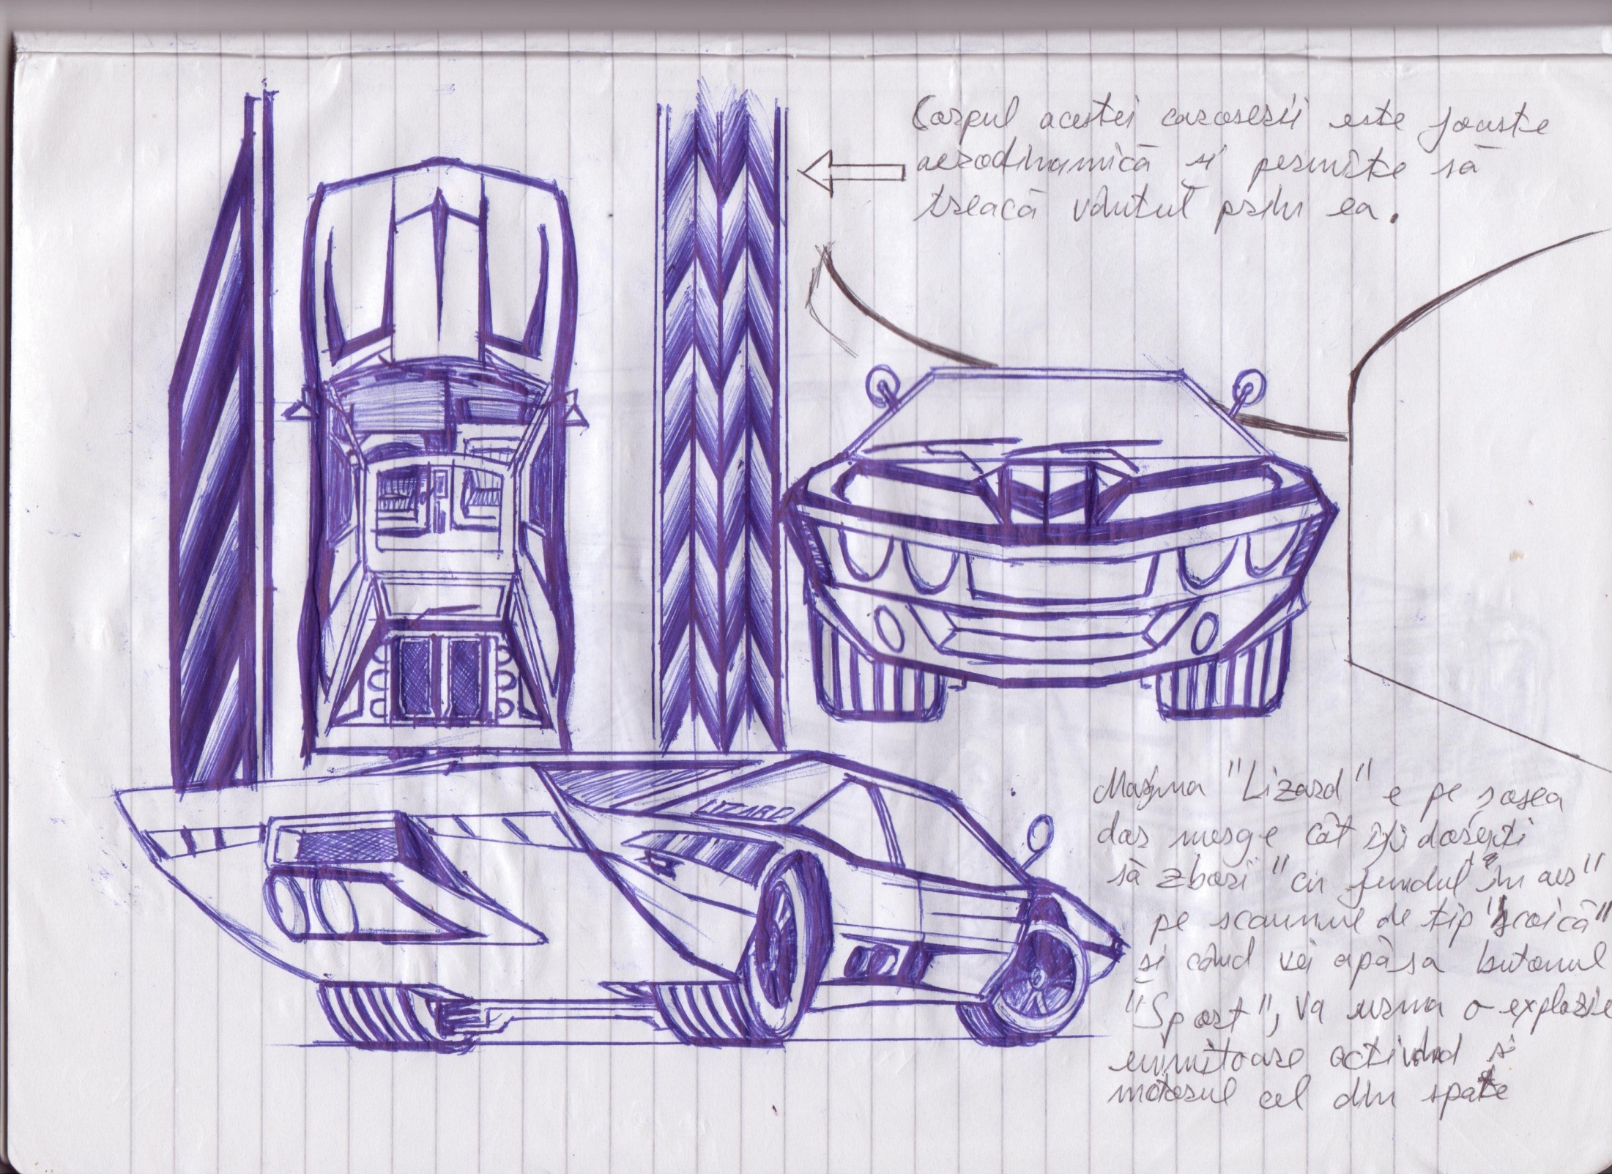
Thank you,

