Slide 1
THE EFFICIENCY OF CHLOROFORM VERSUS ESSENTIAL ORANGE OIL IN ENDODONTIC GUTTA-PERCHA AND SEALER REMOVAL
Author: Ignat Dan Coordinators: Teach.Assit.Anca Torcatoru,
Assoc.Professor.Monica Monea Pop

Slide 2
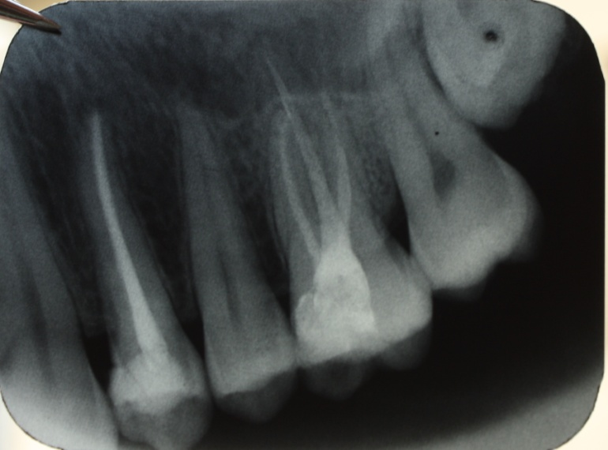
Most endodontic treatments yield a success rate of nearly 90%.
Nevertheless failures can occur and a tooth may require retreatment because of a persistent infection or reinfection of the root canal. For a retreatment to be efficient, safe and complete removal of the root filling material is mandatory.

Slide 3
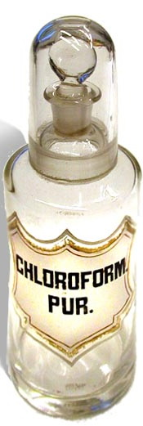
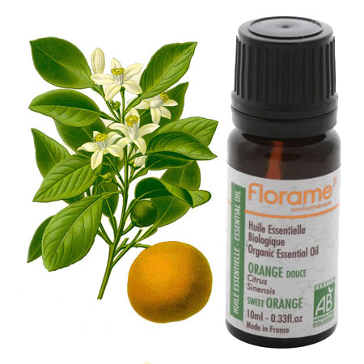
Objective
This study evaluated the efficacy of essential orange oil and chloroform in removing laterally compacted gutta-percha and Endomethasone from the canals of single rooted teeth.

Slide 4
Materials and methods
A number of 28 extracted and decontaminated single-rooted human teeth were used for this study.
Canal preparation with K-files and H-files
Canal filling using lateral condensation technique
Removal of the endodontic filling material and the recording of the elapsed time needed to remove the filling material
Radiographs of the teeth after removal of filling material
Evaluation of the radiographs at 27 magnification in Adobe Photoshop

Slide 5
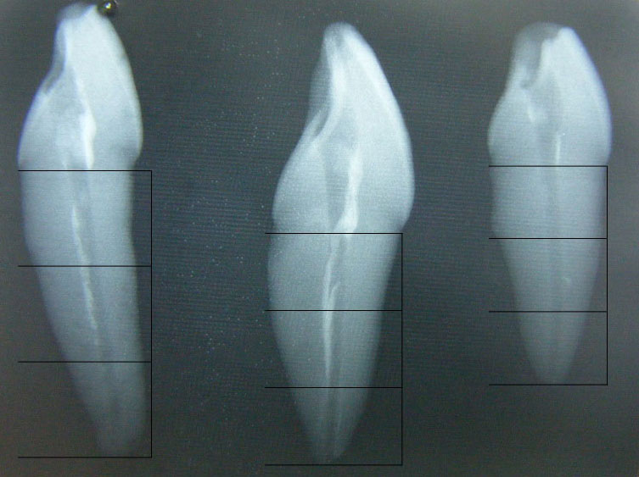
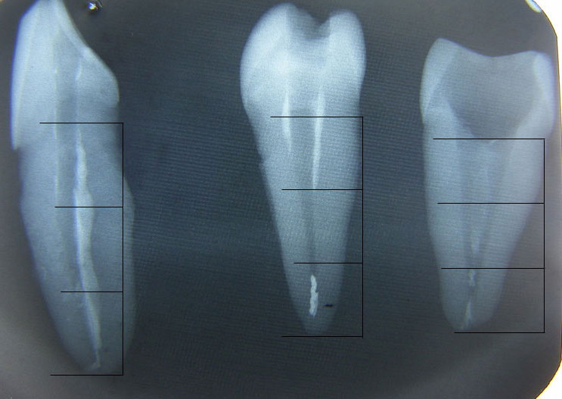
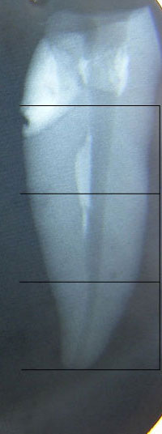
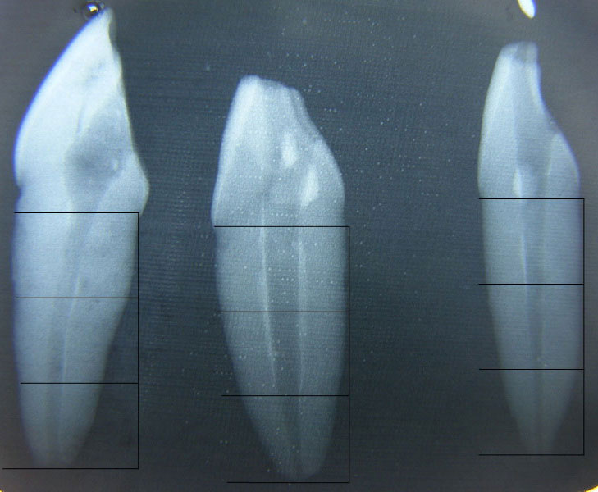
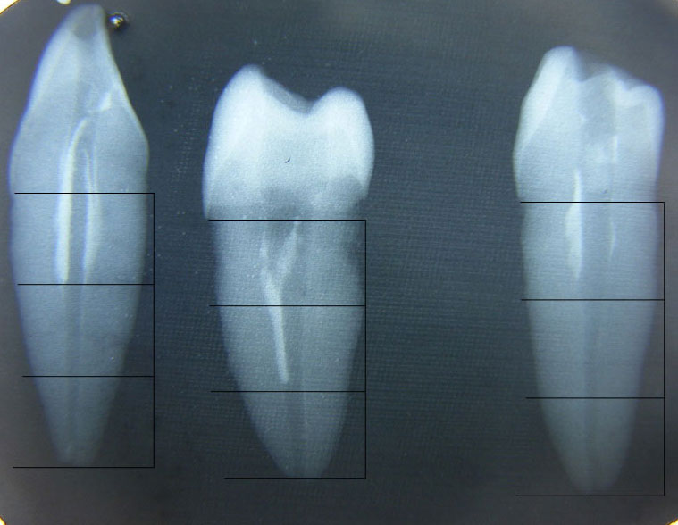
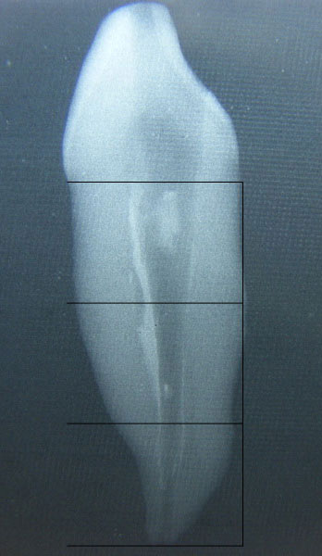
Essential orange oil

Slide 6
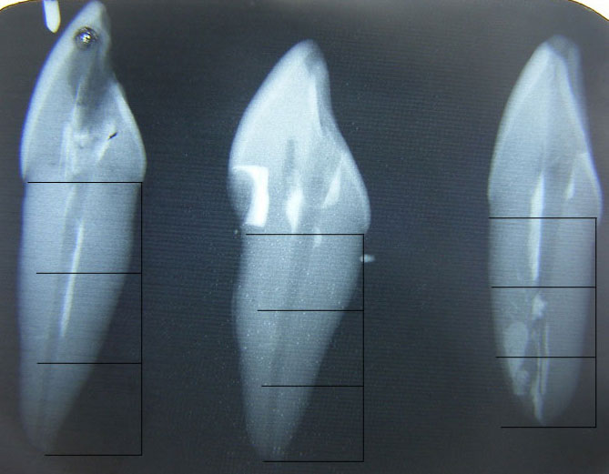
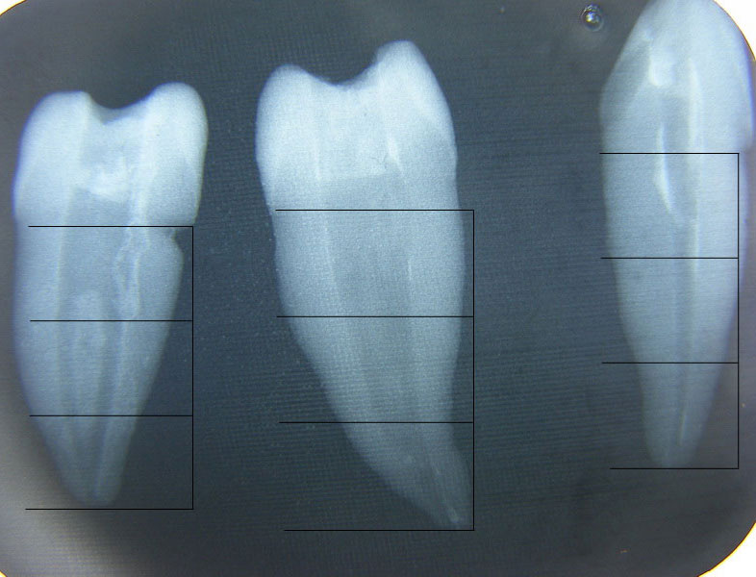
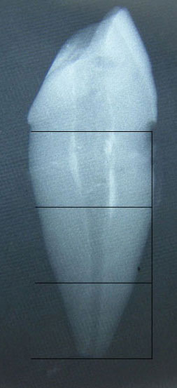
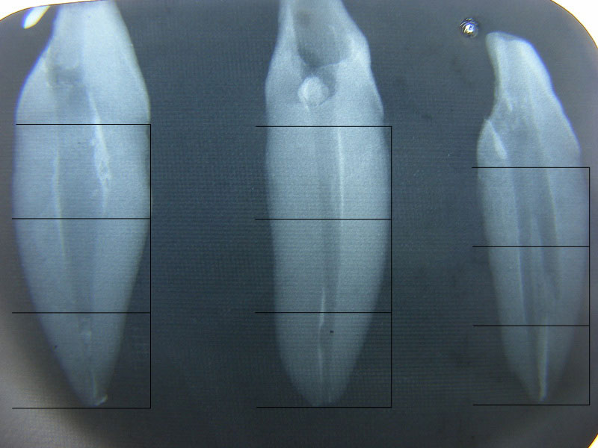
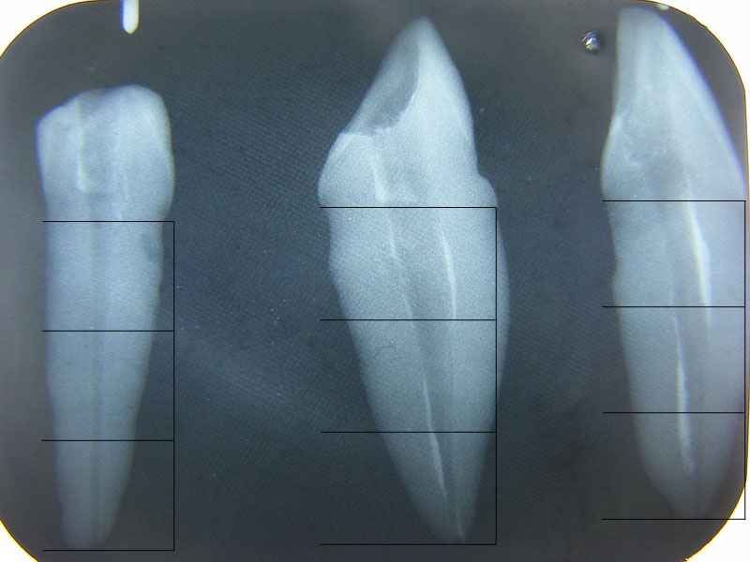
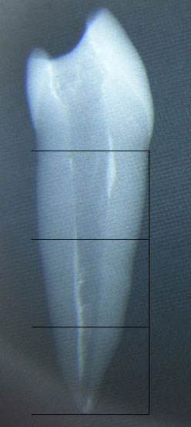
Chloroform

Slide 7
Materials and methods:

Slide 8
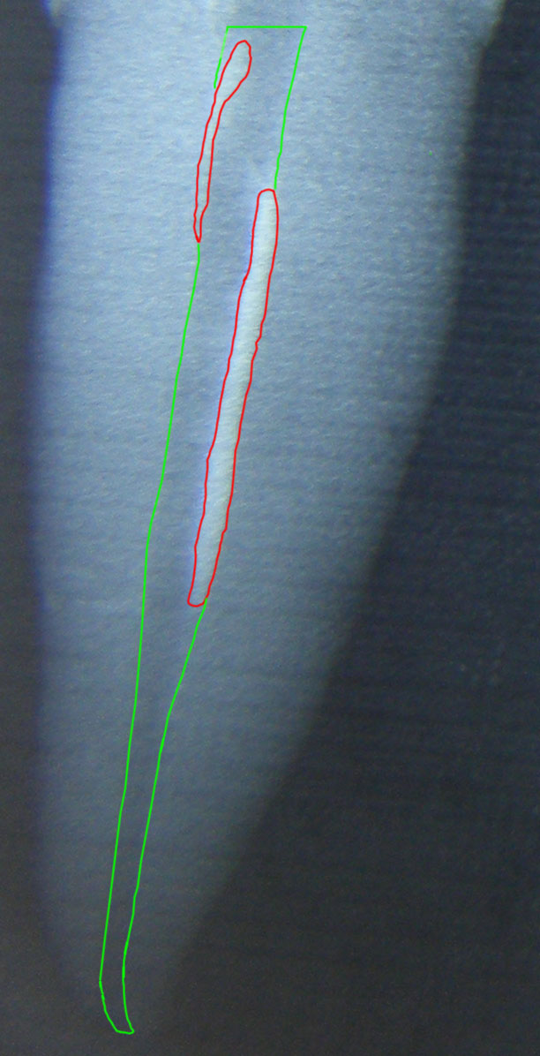
Materials and methods:
Photoshop analysis of the remnant material surface after instrumentation.

Slide 9
Results:
Number of teeth with remnant gutta-percha
Number of teeth with remnant sealer

Slide 10
Results:
Percentage of remnant gutta-percha
Percentage of remnant sealer

Slide 11
Results:
Elapsed time amount for
root filling removal

Slide 12
Conclusions:
Regarding the time amount needed for the retreatment of the teeth, both solvents had roughly the same efficiency.
Regarding the overall amount of remnant gutta-percha removed from the canals, chloroform was 2 times more efficient than orange oil.
it was 2 times less efficient in the removal of gutta/percha from the key areas of the root canal (APICAL third) and 3 times less efficient in the removal of SEALER from the same key areas.
orange oil still remains a viable solution in endodontic retreatment.

Slide 13
Refferences:
Iizuka N, Takenaka S, Shigetani Y, Okiji T. Removal of Resin-based Root Canal Filling Materials with K3 Rotary Instruments: Relative Efficacy for Different Combinations of Filling Materials. Dent Mater J. 2008 Jan;27(1):75-80.
Schirrmeister JF, Wrbas KT, Meyer KM, Altenburger MJ, Hellwig E. Efficacy of Different Rotary Instruments for Gutta-Percha Removal in Root Canal Retreatment. J Endod. 2006 May;32(5):469-72.
Ring J, Murray PE, Namerow KN, Moldauer BI, Garcia-Godoy F. Removing root canal obturation materials. A comparison of rotary file systems and re-treatment agents. J Am Dent Assoc. 2009 Jun;140(6):680-8.
Bodrumlu E, Uzun O, Topuz O, Semiz M. Efficacy of 3 Techniques in Removing Root Canal Filling Material. J Can Dent Assoc. 2008 Oct;74(8):721.
Gergi R, Sabbagh C. Effectiveness of two nickel-titanium rotary instruments and a hand file for removing gutta-percha in severely curved root canals during retreatment: an ex vivo study. Int Endod J. 2007 Jul;40(7):532-7. Epub 2007 May 18.
Pirani C, Pelliccioni GA, Marchionni S, Montebugnoli L, Piana G, Prati C Effectiveness of Three Different Retreatment Techniques in Canals Filled With Compacted Gutta-Percha or Thermafil: A Scanning Electron Microscope Study. J Endod. 2009 Oct;35(10):1433-40. Epub 2009 Aug 22. Erratum in: J Endod. 2010 May;36(5):925.

Slide 14
Thank you for your attention!

