Slide 1
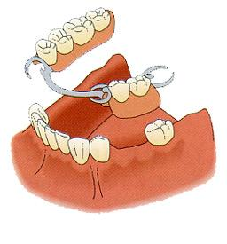
THERAPEUTIC METHODS IN THE TREATMENT OF TERMINAL-LATERAL EDENTULOUS
COORDINATOR : ASIST. UNIV.
DR. CERGHIZAN DIANA
FIRST AUTHOR : COSTIN
BOGDAN

Slide 2
introduction
Partially edentulous dentitions represents a pathophysiological state of the orofacial system, characterized by the absence of one or more, but not all natural teeth.
Common condition among patients with influences upon the quality of their life, with modern therapeutic options.
Most commonly used classifications are those developed by Costa and Kennedy.

Slide 3
- 54 years old female patient with a class II, modification 1 Kennedy partially edentulous maxillary arch, partially treated

Slide 4
exooral EXAMINATIONS
Inspection : symmetric, oval, convex profile, no tegument color changes, vertical dimension of occlusion with no pathologic changes.
Palpation : normal sensitivity and local ganglions without any changes. Higher contraction ratio of the masseter and temporal muscles on the left side.

Slide 5
ENDOORAL EXAMINATIONS
Normal gums, frontal remaining
teeth with fillings, color changes,
with no pathologic mobility,
presenting a dental
bridge from 2.3 to 2.8.
Distal residual ridge
horizontally with
Class I maxillary tuberosity,
favorable palate, and a second
degree of atrophy -> higher atrophy on the vestibular side because
of the centripetal atrophy of the maxillary bone.

Slide 6
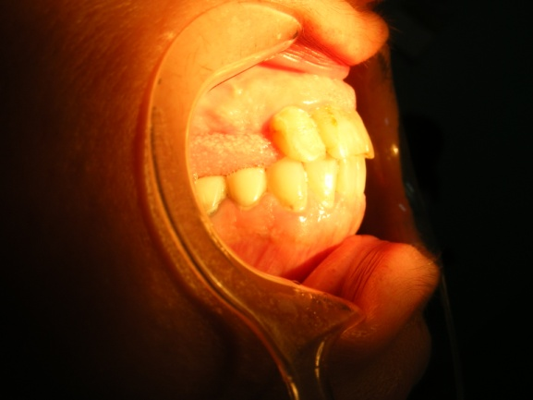
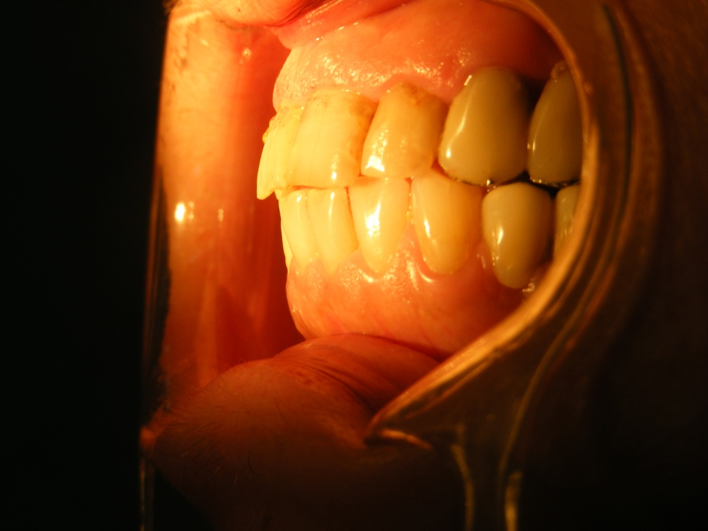
OCCLUSION EXAMINATION
Sagittal : physiologic
occlusion on the canine
and incisive
Transverse : normal ratio
Vertical : normal as well
with the exception of the
non existing overbite.

Slide 7
DIAGNOSIS
After all the treatments that precedes the treatment plan for the removable partial denture were fulfilled the diagnosis of class II, modification 1 Kennedy partially edentulous arch remains unchanged.

Slide 8
Therapeutic options
Dental bridge
Acrylic removable partial denture
Removable partial denture
Oral implants

Slide 9
After visual examination, radiographs, oral prophylaxis, evaluation of teeth and periodontium, vitality tests of individual teeth, and impressions of each arch the most adequate treatment was chosen reporting it to the oral condition, the age, and the financial state.

Slide 10
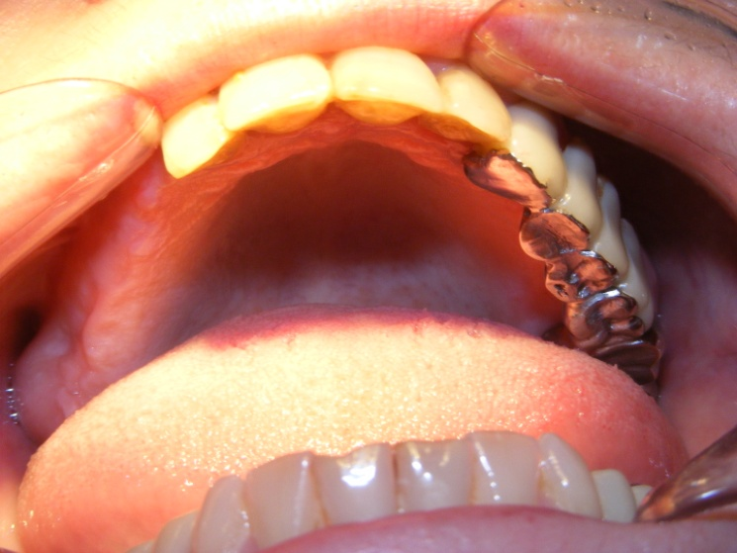
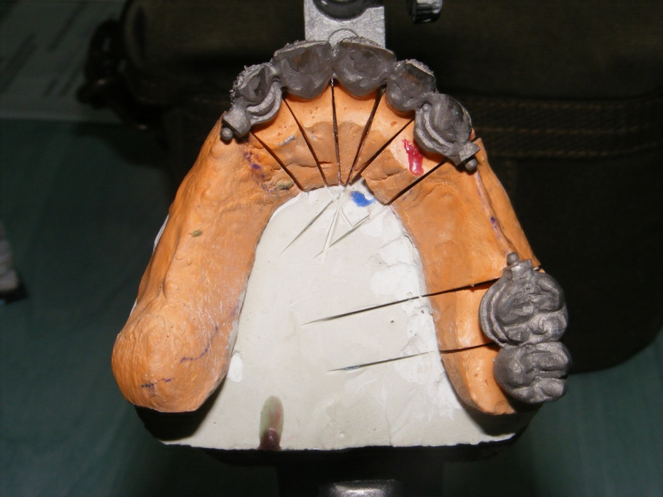
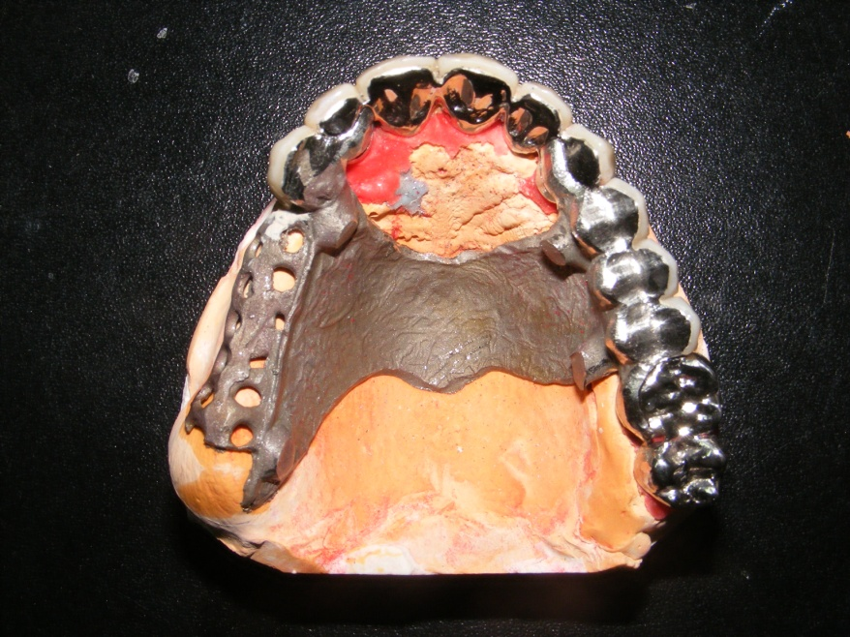
Chosen treatment
In this case we
opted for the
removable partial denture .

Slide 11
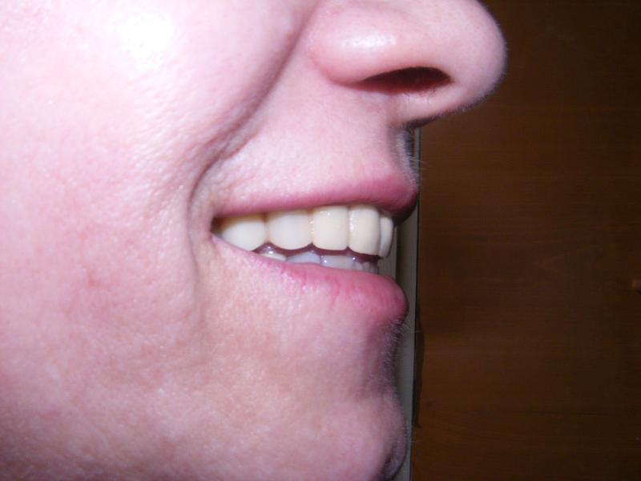
Results
Rehabilitation of occlusion
Higher masticatory efficiency
Bilateral mastication
Improved phonetic
Improvement of aesthetic

Slide 12
VA MULTUMIM
!!!

