Slide 1
POSTOPERATIVE EVALUATION STUDY OF CAROTID STENOSIS RESOLVED IN PLEXUS AND LOCAL ANAESTHESIA
Author: Pop Raluca Alexandra
Coordinator: Univ.Asist. Dr. Muresan Adrian

Slide 2
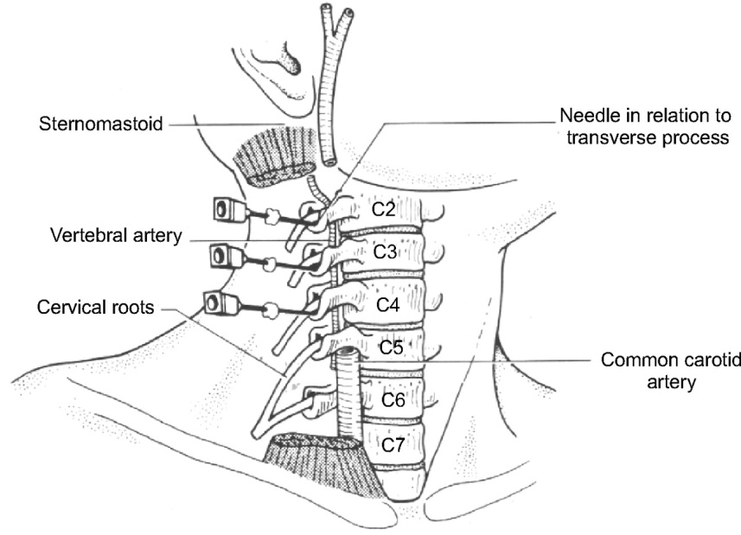
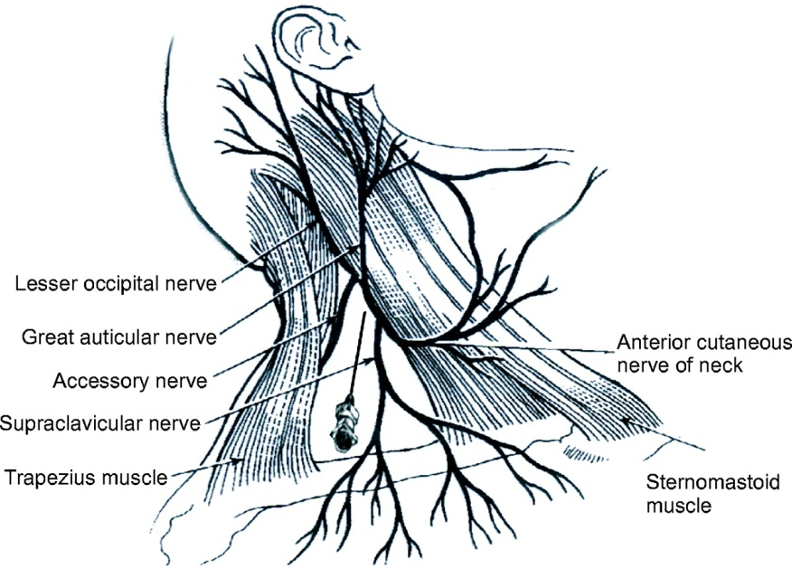
There is an increasing trend in many centres worldwide towards the use of plexus and local anaesthesia for carotid endarterectomy as the awake pacient provides the best possible monitoring of the cerebral function during carotid cross clamping and it may reduce considerable the requirement for shunt placement
Deep cervical plexus block
Superficial cervical plexus block showing needle position

Slide 3
We present three cases of pacients admitted and operated between 2009-2010 in the Surgical Clinic I from Targu-Mures, all three with the diagnosis of carotidian stenosis for which has been practiced carotidian trombendarterectomy under combined plexus and local anaesthesia

Slide 4
First case
52 years old pacient, female
admitted by appointment
non-smoker
history of stroke in 2005, with left hemiparesis
Paraclinical exams:
Laboratory:TGL – 146,92 mg/dl
LDHI – 739 U/l
CK – 554 U/l
Doppler exam, wich revealed an 75-80% stenosis of the
right internal carotid

Slide 5
Second case
56 years old, male
admitted by appointement
smoker
many organ dissorders asosciated: history of stroke (2010), left hemiparesis, hyperthension, cardiomyopathy, tipe 2 diabetes, multivascular disease
Paraclinical exams:
Laboratory: no pathological changes
Doppler exam: 70% stenosis of the right carotidian bulb
55% stenosis of the left carotidian bulb and proximal carotid artery and 87% from the internal left carotid artery

Slide 6
Third case
53 years old,male
admitted in emergency, presenting right hemiparesis, aphasia, acalculia, agraphia
smoker
associated diseases: hypertension, cardiomyopathy, ischemic stroke
Paraclinic exams:
Laboratory: no pathological changes
Doppler exam: 75-80% stenosis of the left commune
carotid and left internal carotid

Slide 7
Surgery
Trombendarterectomy
Primary arterial suture
Drain contact
Without use of arterial shunt
Average time of surgery 30 minutes

Slide 8
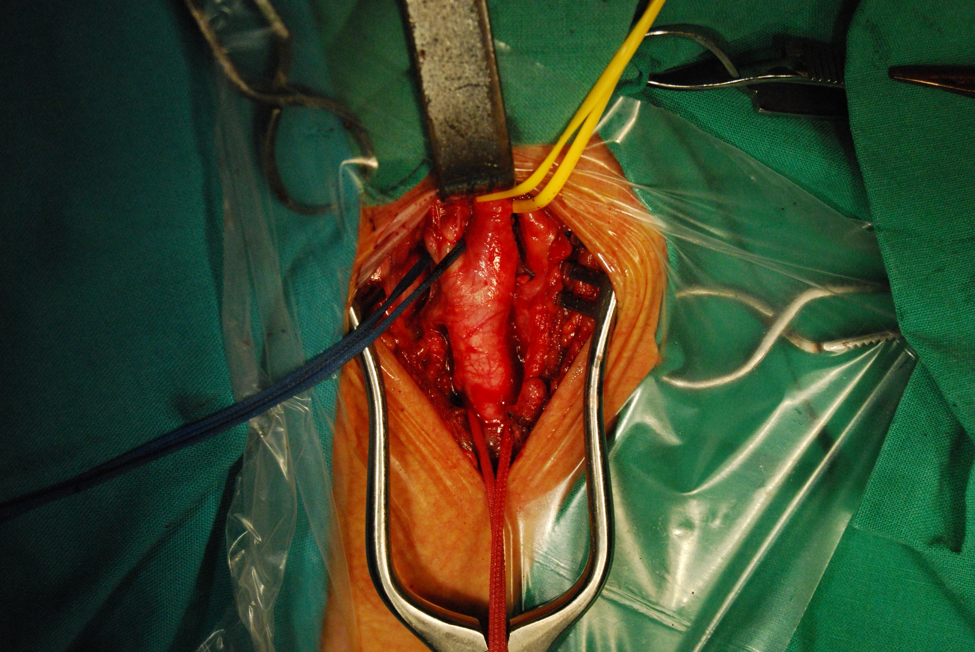

Slide 9
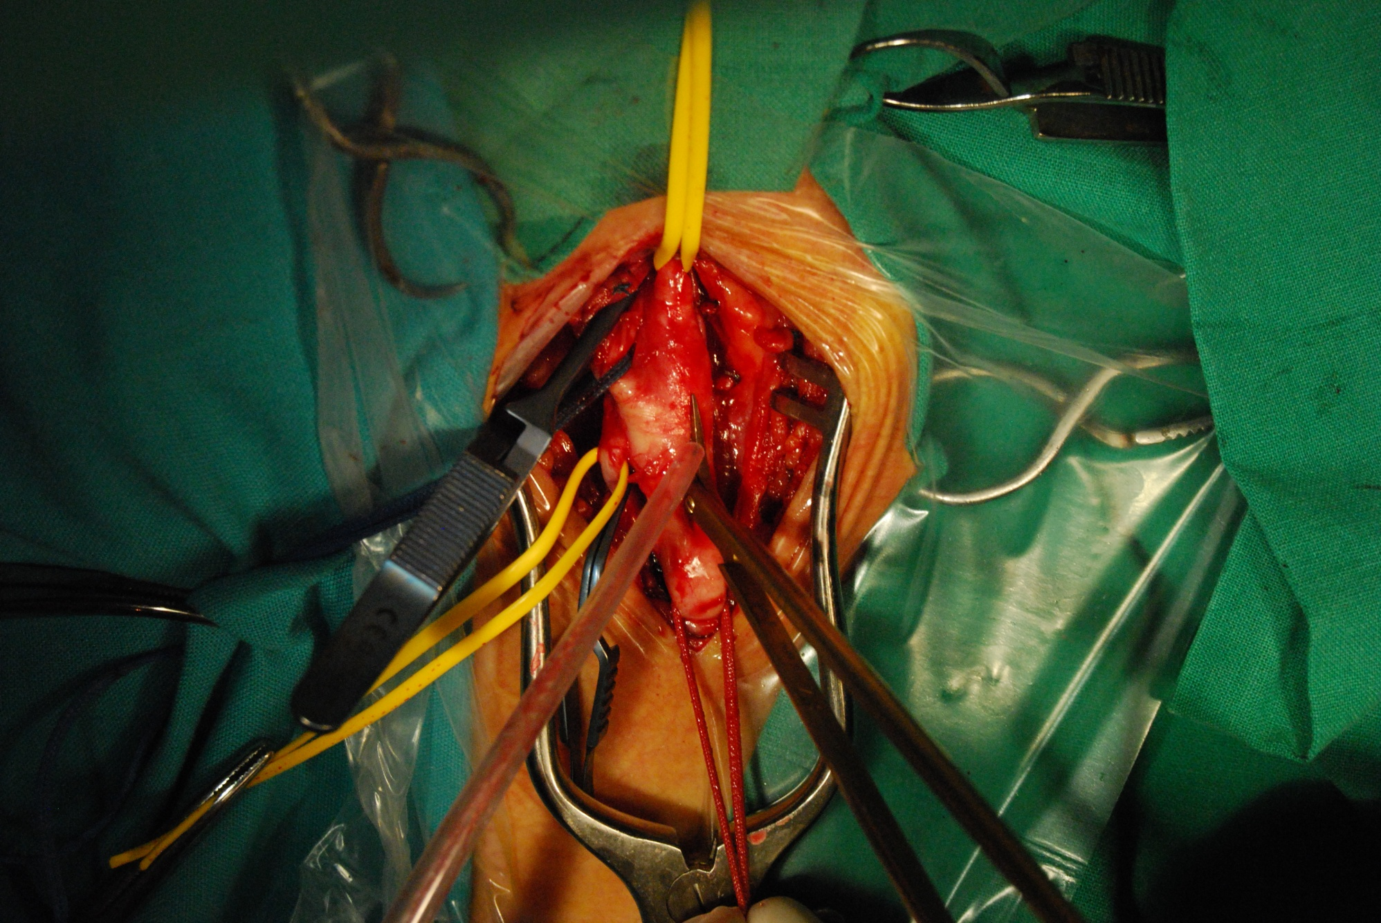

Slide 10
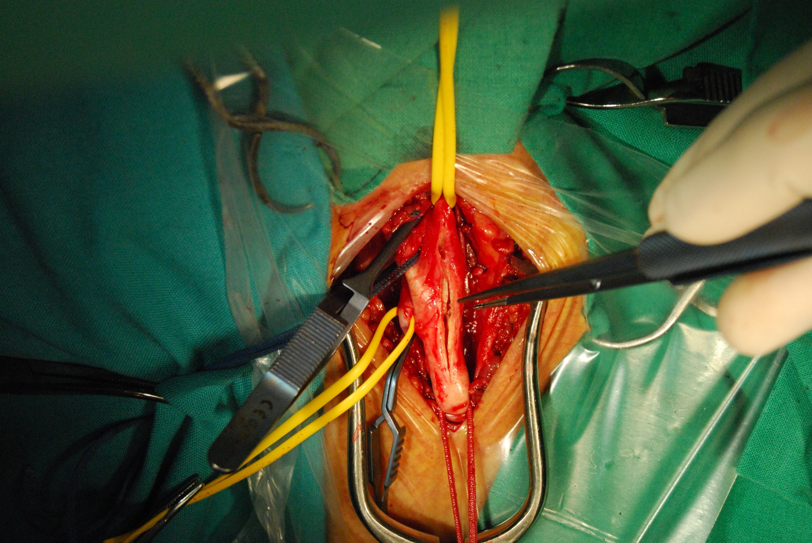

Slide 11
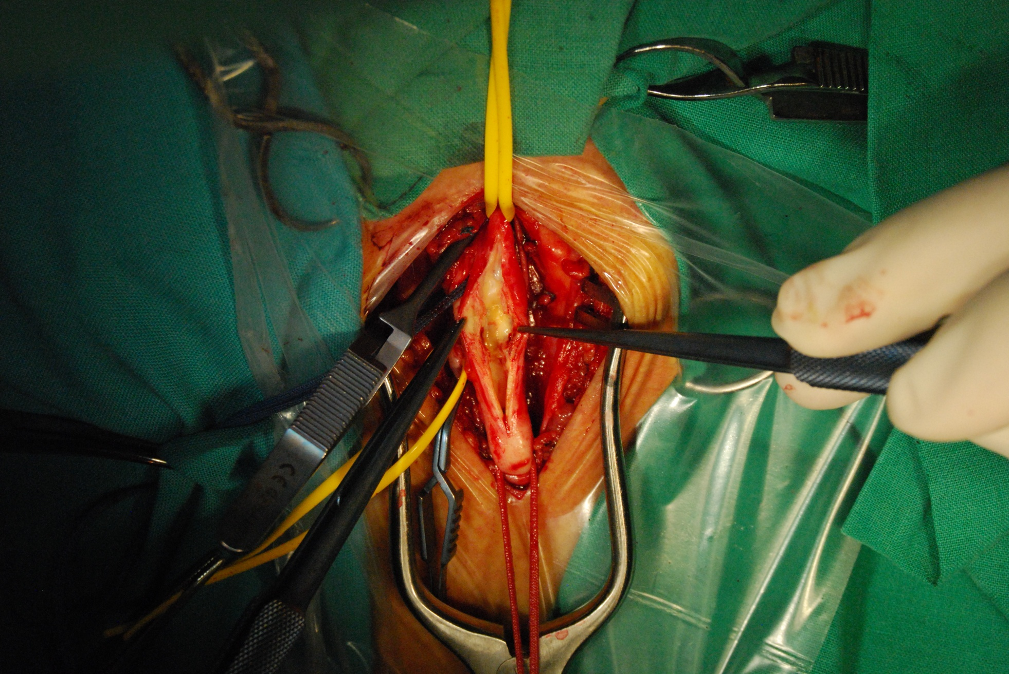

Slide 12
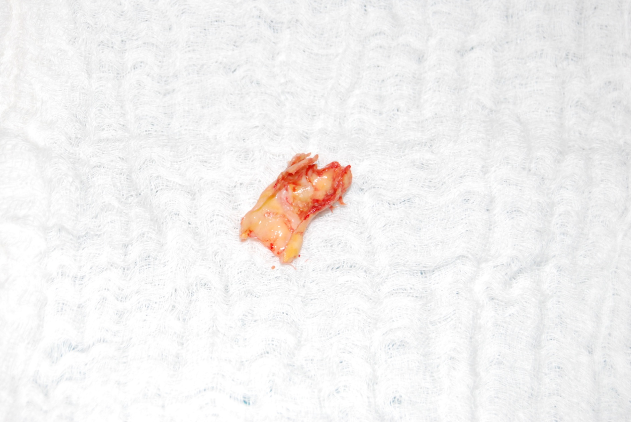

Slide 13
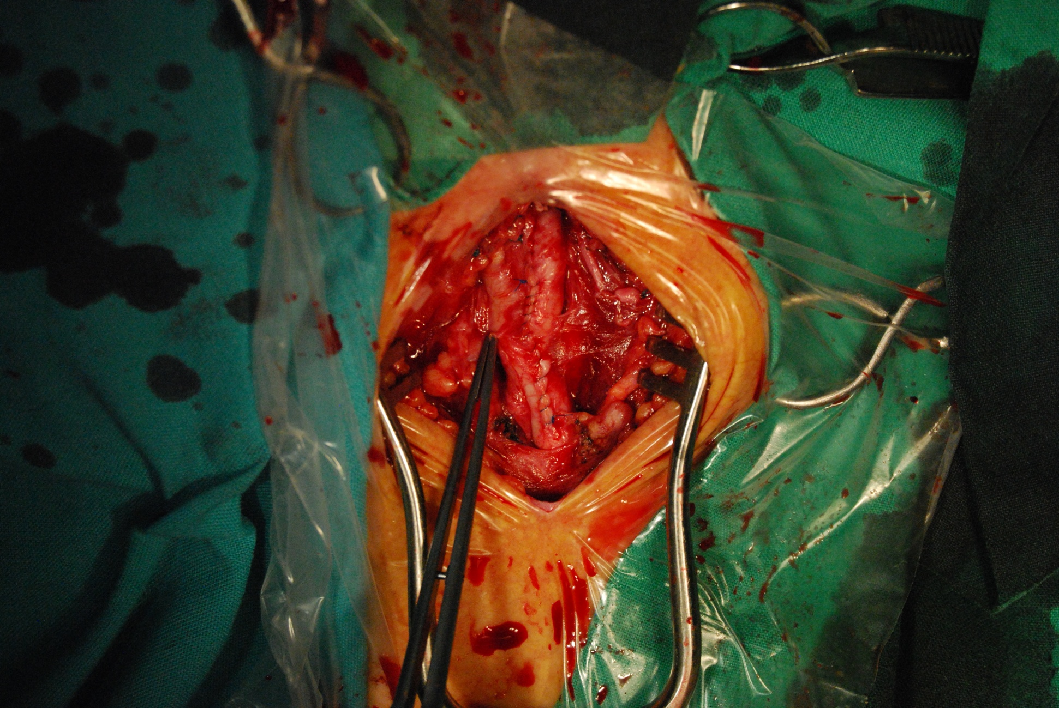

Slide 14
Postoperation
Eco Doppler
Evolution:
convenient, without any complication
no neurological outcomes
average time of hospitalization 3 days

Slide 15
Regional Anaesthesia
A regional technique for CEA requires the correct combination between pacient, surgeon and anesthesist
CEA requires block of C2-C4
May be used superficial block, deep block, straight local or combination between them

Slide 16
GALA trial
An international multicentre trial comparing general anaesthesia versus local anaesthesia for carotid surgery
the trial involved 3.526 pacients with symptomatic or asymptomatic carotid stenosis, randomised to surgery under general (n=1753) or local (n=1773) anaesthesia
the primary outcome was the proportion of patients with stroke (including retinal infarction), myocardial infarction, or death between randomisation and 30 days after surgery

Slide 17
GALA trial
The researchers concluded that “the hypothesis that local anaesthesia is better than general anaesthesia for carotid endarterectomy is based on the idea that it is associated with more appropriate and less frequent shunt use, fewer, cardiorespiratory complications, and preserved cerebrovascular regulation. However, in this study, although general anaesthesia was associated with a slightly higher risk than local anaesthesia of perioperative stroke, myocardial infarction, or death, this difference was not statistically significant”

Slide 18
Conclusions
Selected cases of carotidian stenosis may be carried out
in plexus and local anaesthesia with several benefits:
enables the surgeon to assess the neurological status during the procedure
it is also associated with decreased shunt usage, decreased operative time and shorter length of hospital stay

Slide 19
References
Tangkanakul C, Counsell C, Warlow C. Local versus general anaesthesia for carotid endarterectomy. Cochrane Database Syst Rev 2002
AANA Journal/June 2007/vol.75,no.3
The Lancet, Volume 372, Issue 965, Pages 2132 - 2142, 20 December 2008

Slide 20
Thank you!

