Slide 1
CONGENITAL HEART DISEASE MANAGEMENT IN NEWBORNS
First Author:
Roman Flavia-Cristina Coordinators:
Lecturer Physicians - Horatiu Suciu
-Manuela Cucerea

Slide 2
CHD
A baby born with heart defects has Congenital Heart Disease(CHD). These may include:
some parts of the heart do not develop normally;
changes in the flow of blood;
hypoxia;
the heart's rhythm is affected.

Slide 3
Classification of CHD
Acyanotic, L-R Shunts;
Acyanotic, no Shunts;
Cyanotic CHD;
General CHD.

Slide 4
CHD
- 1-3% of all congenital diseases;
- 0,6% of live newborns.

Slide 5
The Incidence of CHD
VSD 30,5%
ASD 9,8%
PDA 9,7%
PS 6,9%
CoA 6,8%
AS 6,1%
TOF 5,8%
TGA 4,2%
CAT 2,2%
TA 1, 3%

Slide 6
February 2007-February 2011 Neonatology of “Spit.Clinic Jud.de Urgenta Tg.Mures”
CoA = 10
TOF = 6
TGA = 52
PDA = 36
AV block = o

Slide 7
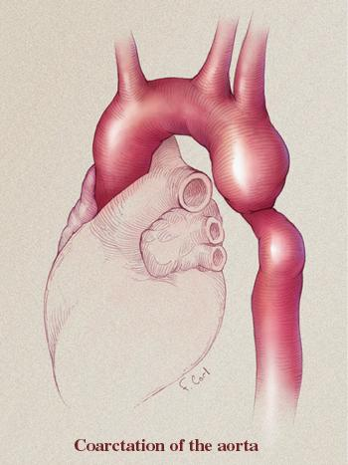
Coarctation of the Aorta

Slide 8
CoA= CHD whereby the aorta narrows in the area where the PDA inserts, just past the origin of the left subclavian artery.
In association with PDA:
preductal;
ductal;
postductal.

Slide 9
Physiopathology & Clinical signs
proximal arterial hypertension(headaches, nosebleeds);
distal low blood pressure, cold legs and feet, weak pulse;
CHF(Congestive Heart Failure);
Chest pain.

Slide 10
Surgical method

Slide 11
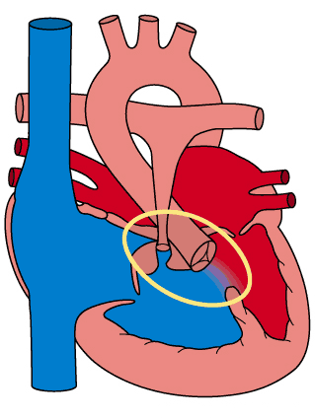
TOF-tetralogy of FALLOT
The main Cyanotic Heart disease!!!

Slide 12
TOF= PS, overriding Aorta, VSD, Right ventricular hypertrophy.

Slide 13
Physiopathology & Clinical signs
Cyanotic form: severe cyanosis,low oxygenation of blood, weight deficiency, clubbing of fingers/toes;
Acyanotic form: minor shunt/PS
Associated with Pulmonary Atresia: -large shunt;
-PDA.
Pink Fallot

Slide 14
Surgical method- neonatal period

Slide 15
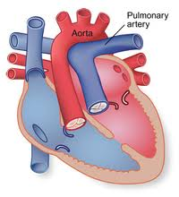
Transposition of Great Arteries TGA=the pulmonary arteries are supplied by the left ventricle, and the aorta by the right ventricle

Slide 16
Physiopathology & Clinical signs
Low oxygenation of tissues, hypoxia convulsions
TGA with ASD: severe cyanosis, tachypnea, tachycardia;
TGA with VSD/PDA;
TGA with PS: severe cyanosis.

Slide 17
Surgical method

Slide 19
Patent Ductus Arteriosus

Slide 20
PDA= the persistence of a normal fetal structure between the left pulmonary artery and the descending aorta(beyond 10 days of life).
-after closure, fibrotic remnants of DA are called: ligamentum arteriosum(Botallo).

Slide 21
Physiopathology & Clinical signs
small PDA(no significant hemodynamic consequences);
medium PDA;
large PDA: high pulmonary blood flow
cardiac failure

Slide 22
Surgical method

Slide 23
Congenital Atrioventricular Block

Slide 24
AV block= involves the impairment of the conduction between the atria and the ventricles of the heart.
Third degree AV block - No association between P waves and QRS complexes.

Slide 25
Physiopathology & Clinical signs (third degree AV Block)
no relationship between P waves and QRS complexes;
bradycardia;
hypotension;
syncope.

Slide 26
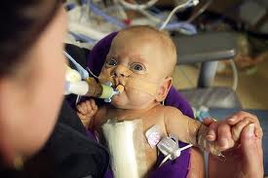
Surgical method

Slide 27
Conclusions
In neonatal period, the most common CHDs benefitting of surgery are TGA, PDA, CoA, TOF+PA, AV block.
Surgery is performed if symptoms are severe and endanger the baby’s life or the medication is not satisfactory.
Excepting TGA(preferable surgery approach:14-21days)
The importance of: -the hospital/services provided;
-the team of specialists + a correct diagnosis;
-prenatal diagnosis.

Slide 28
“The heart has its reasons of which reason knows nothing.”
Blaise Pascal

Slide 29
Thank you!!

