Slide 1
ECHINOCACTUS WILLIAMSII: - THE PROMISE OF AN “ESCAPE” IN ETHNOBOTANICAL SHOPS
Author Coordinators
Koblos Ana-Andreea Prof. Dr. Silvia Oroian
Faculty of Pharmacy Conf. Univ. Dr. Augustin Curticapean
The purpose of this work is to expose the psychedelic properties of a cactus species Echinocactus williamsii, whose origins have been lost in the history of the Native American tribes.

Slide 2
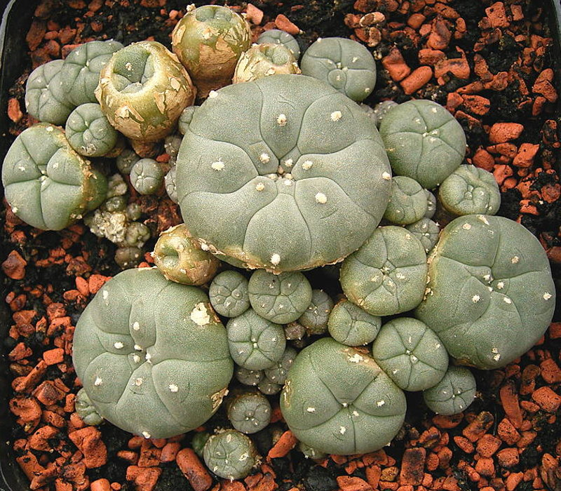
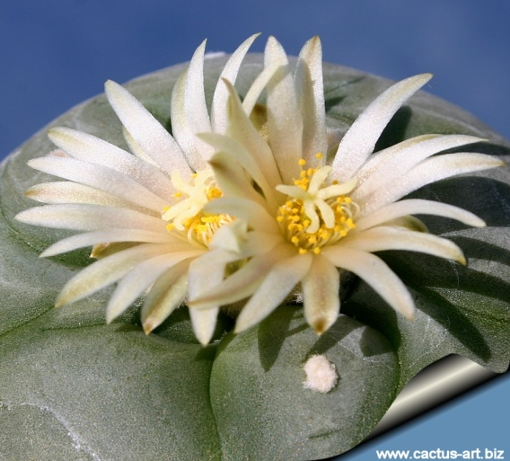
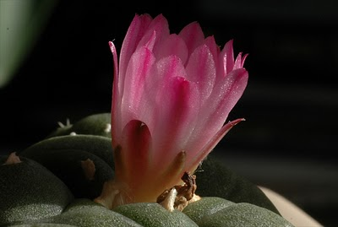
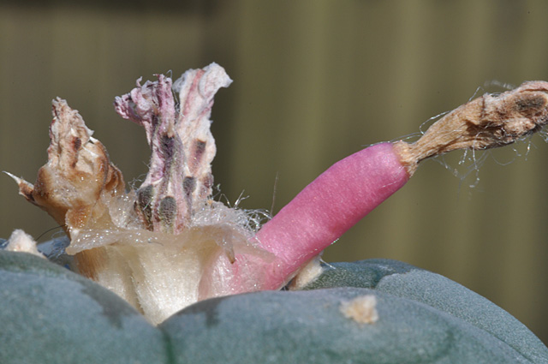
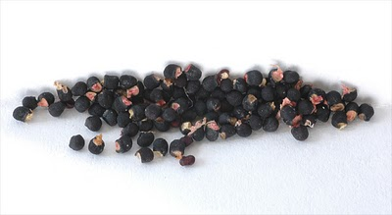
DESCRIPTION
Small cactus, greenish blue.
Cylindrical stalk divided into 5 to 13 thick ribs.
Flowers - pink, white or yellowish, solitary, small, infundibuliform.
Fruits - flesh coloured or greenish yellow.
Seeds - small and black.

Slide 3
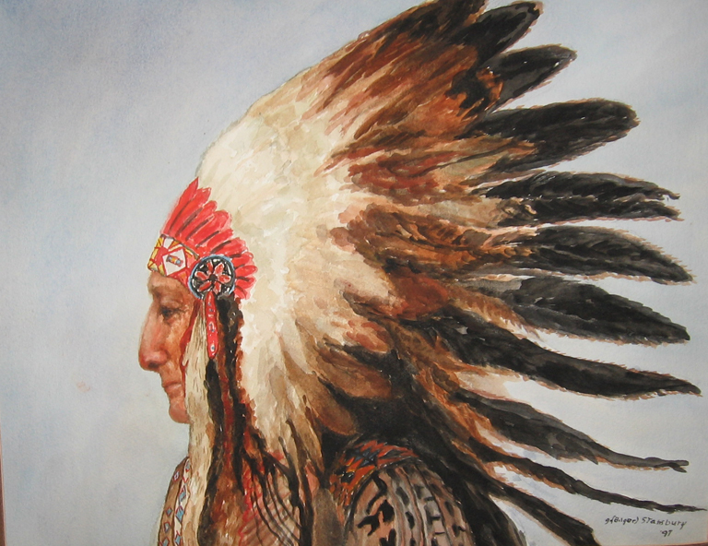
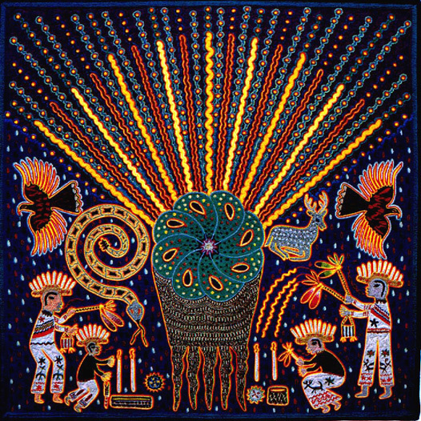
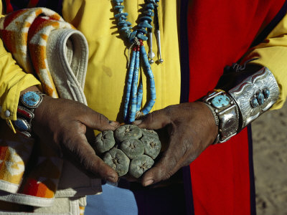
HISTORY
Collected and used by the indigenous people of North America ever since the years 3780-3660 BC.
The Huichol for ceremonial purposes.
Means of communicating with the spirit world.
Four principal deities:
1.The trinity of Corn
2. Blue Deer
3. Peyote
4. Eagle, all descended from their Sun God.

Slide 4
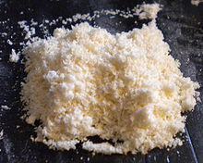
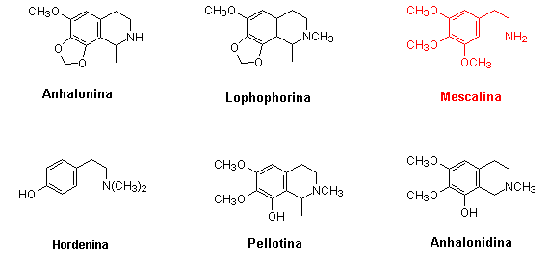
CHEMICAL STRUCTURES AND MIXTURES
The Peyote alkaloids can be divided into three groups:
Group 1: Mescaline: ( C₁₁H₁₇NO₃ )
Group 2 : Anhalamine: (C₁₁H₁₅NO₃ )
Anhalonidine : ( C₁₂H₁₇NO₃ )
Peyotine: ( C₁₃H₁₉NO₃ )
Group 3 : Anhalonine : ( C₁₂H₁₅NO₃ )
Lophophorine : ( C₁₃H₁₇NO₃ )

Slide 5
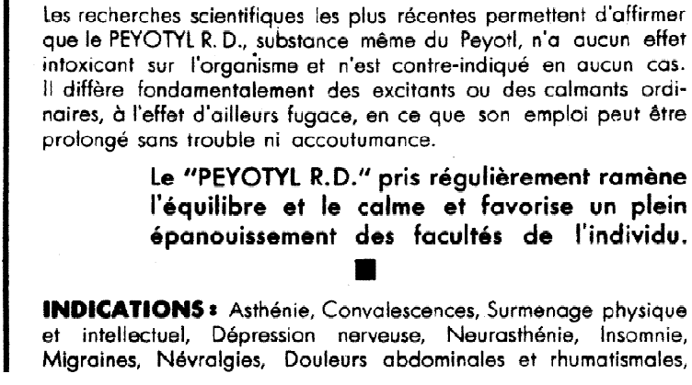
MECHANISM OF ACTION
Mescaline
activates the serotonin 5-HT_{2A} leads to psychedelia is still unknown, but it likely somehow involves excitation of neurons in the prefrontal cortex.
activates the serotonin 5-HT_{2C} receptor.
stimulates the dopamine receptors.

Slide 6
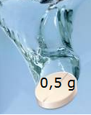
EFFECTS - Psychological Effects
Synesthesia
Visual hallucinations
Abnormal touch, taste and smell
Auditory hallucinations
Disturbances of the will
Disturbances of the perception of space and time

Slide 7
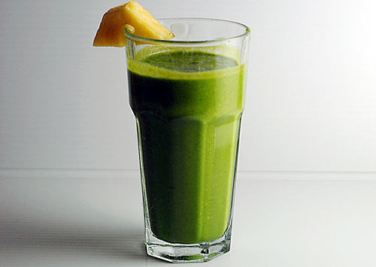
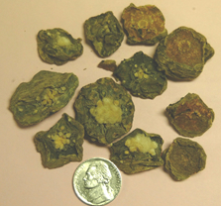
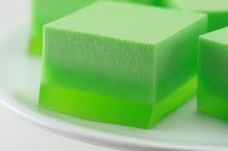
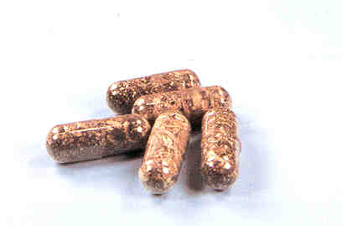
“WORLD OF COLORFUL DREAMS”

Slide 8
CONCLUSIONS
E. williamsii is native to southern North America- his consumption is prohibited by law ( nr143/2000; nr.339/2005)
Its main alkaloid is mescaline (> 0,5 g hallucination effects )
3. Just say no to ethnobotanical plants, no to Echinocactus williamsii, no to mescaline!!!!

