Slide 1
Electronic axiography. Considerations on a clinical case.
First Author : Herescu Bogdan
Coordinators: Prep. Univ. Drd. Şoaită Claudia,
Prof. Univ. Dr. Popşor Sorin

Slide 2
Prevalence of the cranio-mandibular dysfunction

Slide 3
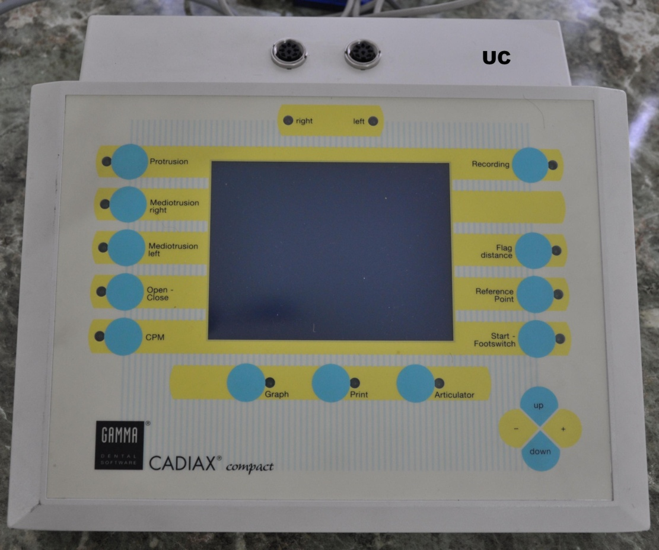
Operating principle and components of CADIAX Compact system
Main operating system is based on electronic registration of mandibular kinematics through the electromagnetic sensors
from some registration plates.
CADIAX device offers:
bilateral, simultaneous, timed 3D registration of condylar movement;
registration of sagittal and transversal condylar tracks;
automatic conversion of the joint track curves for the articulator
registration of hinge axis rotation;
hinge axis calculation and adjustment with real-time display
individual or standardized registrations according to Prof. Slavicek

Slide 4
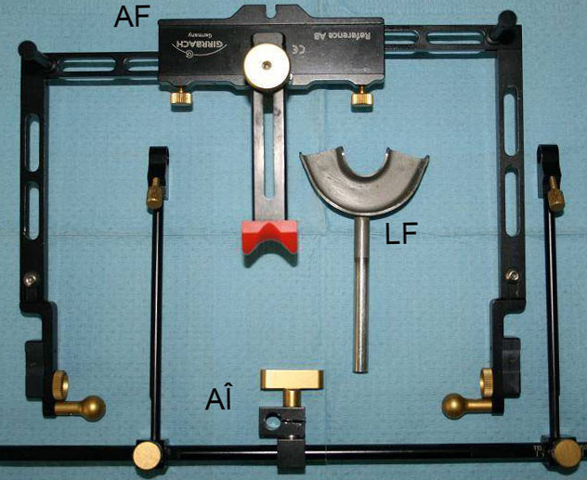
Components of CADIAX Compact system

Slide 5
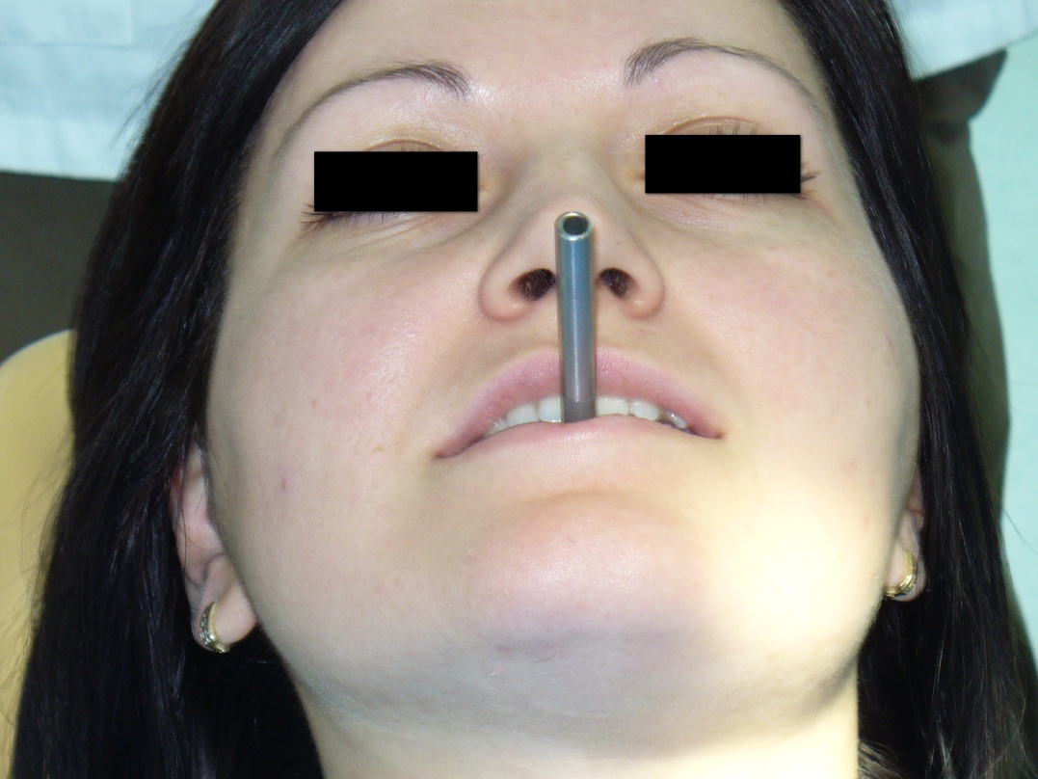
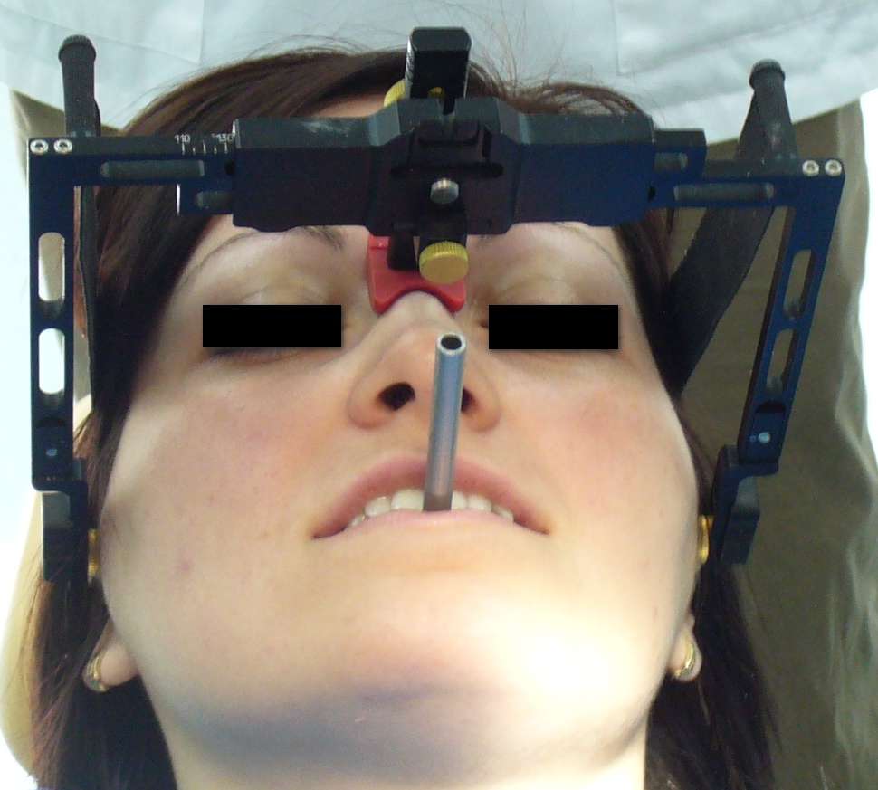
Registering steps on a patient who presented to the Department of Prosthodontics and Oral Rehabilitation of Târgu Mureş accusing repeated mandibular subluxations associated with TMJ pain

Slide 6
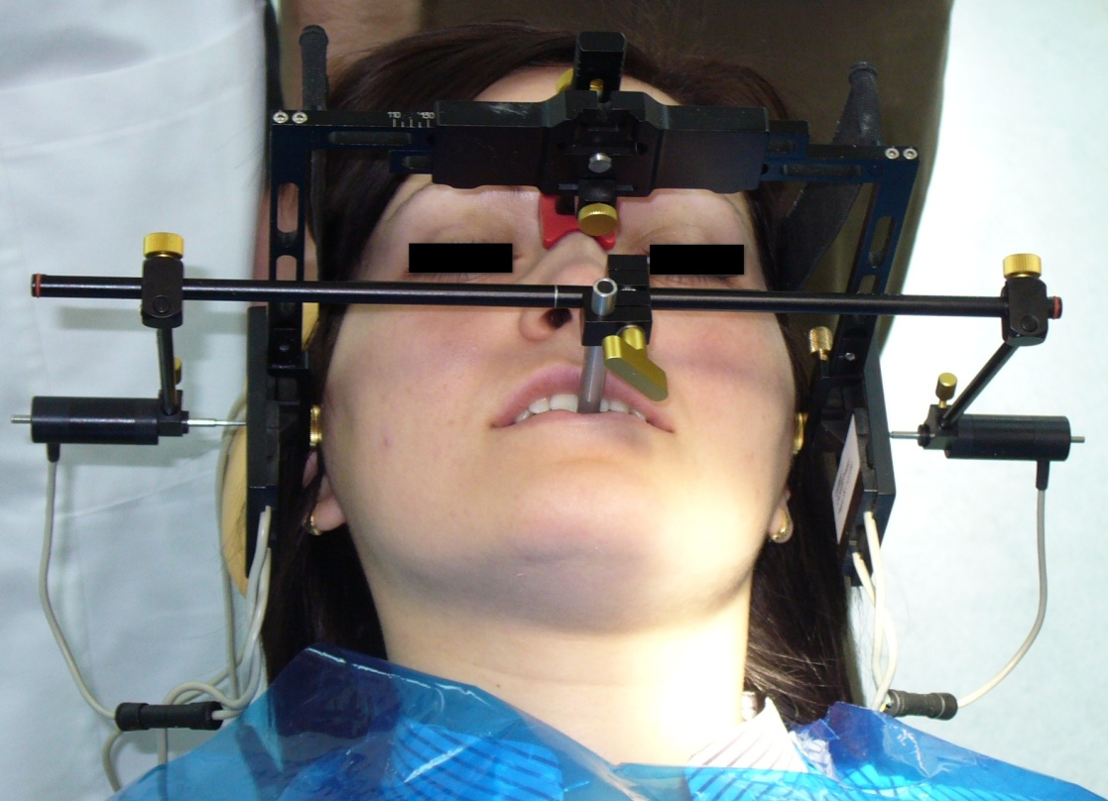
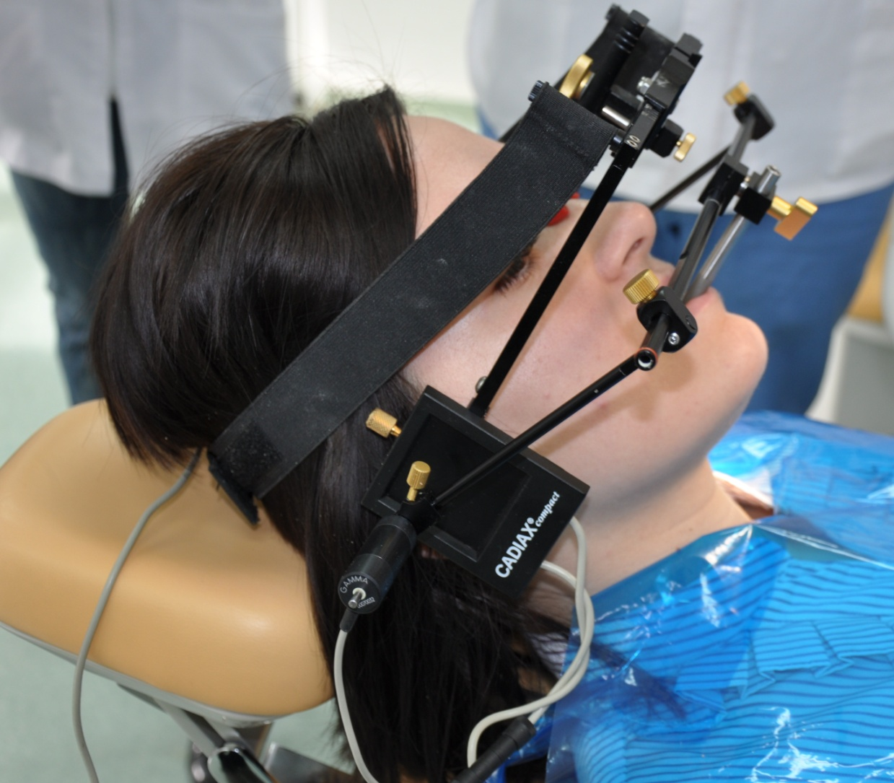
Registering steps on a patient who presented to the Department of Prosthodontics and Oral Rehabilitation of Târgu Mureş accusing repeated mandibular subluxations associated with TMJ pain

Slide 7
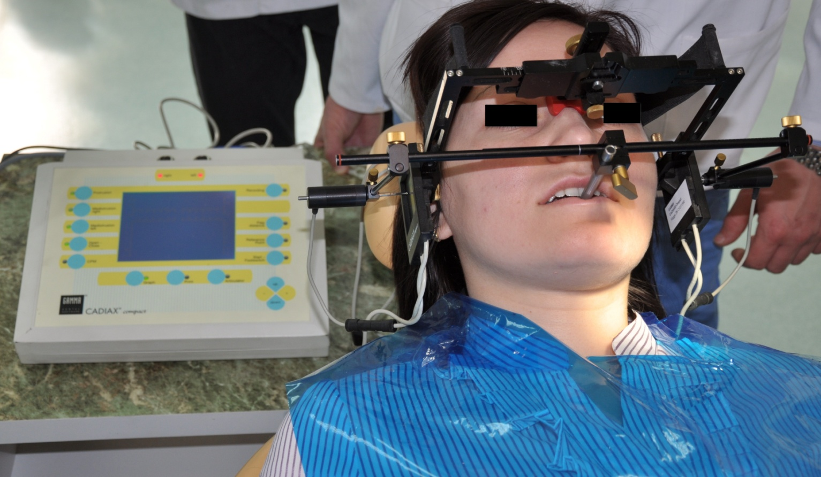
Connecting systems linking central unit and recording elements.

Slide 8
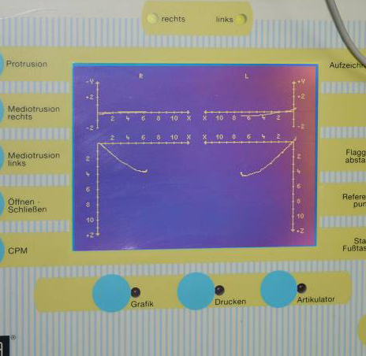
Recording the position of centric relation
Recording the protrusion of the mandible

Slide 9
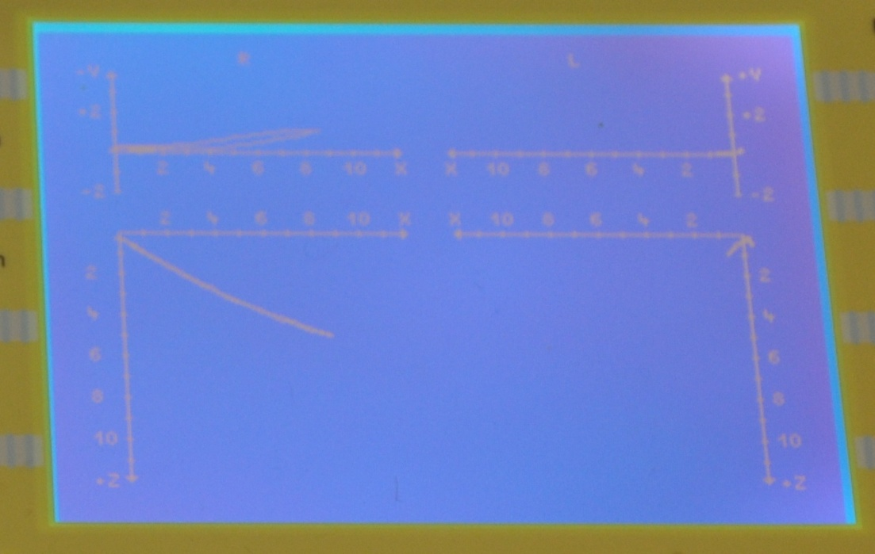
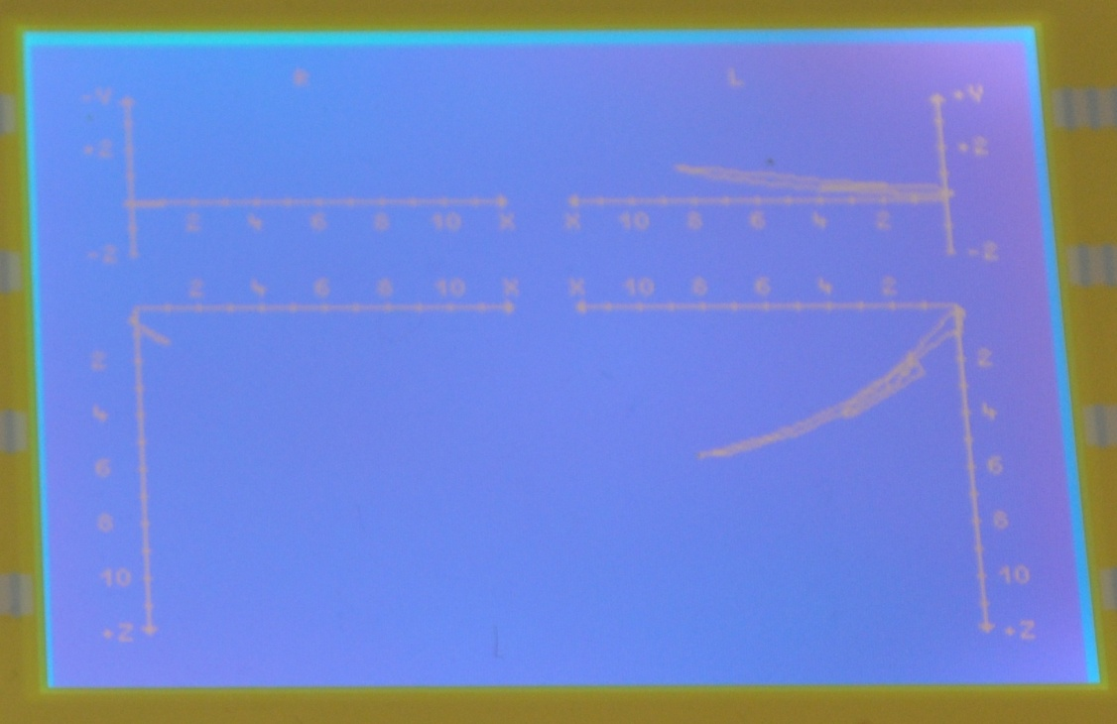
Recording the lateral excursion to the left
Recording the lateral excursion to the right

Slide 10
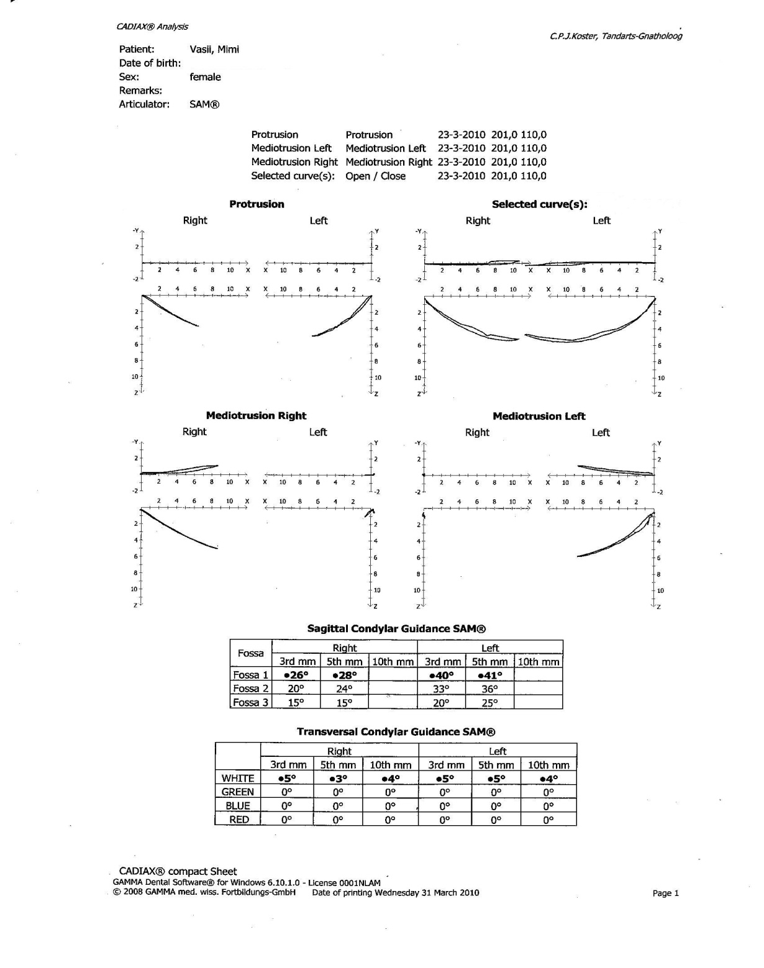
The recorded informations are saved in a computer and are printed to be attached to personal records of the patient.
Source: C.P.J. Koster, Tandarts-Gnatholog

Slide 11
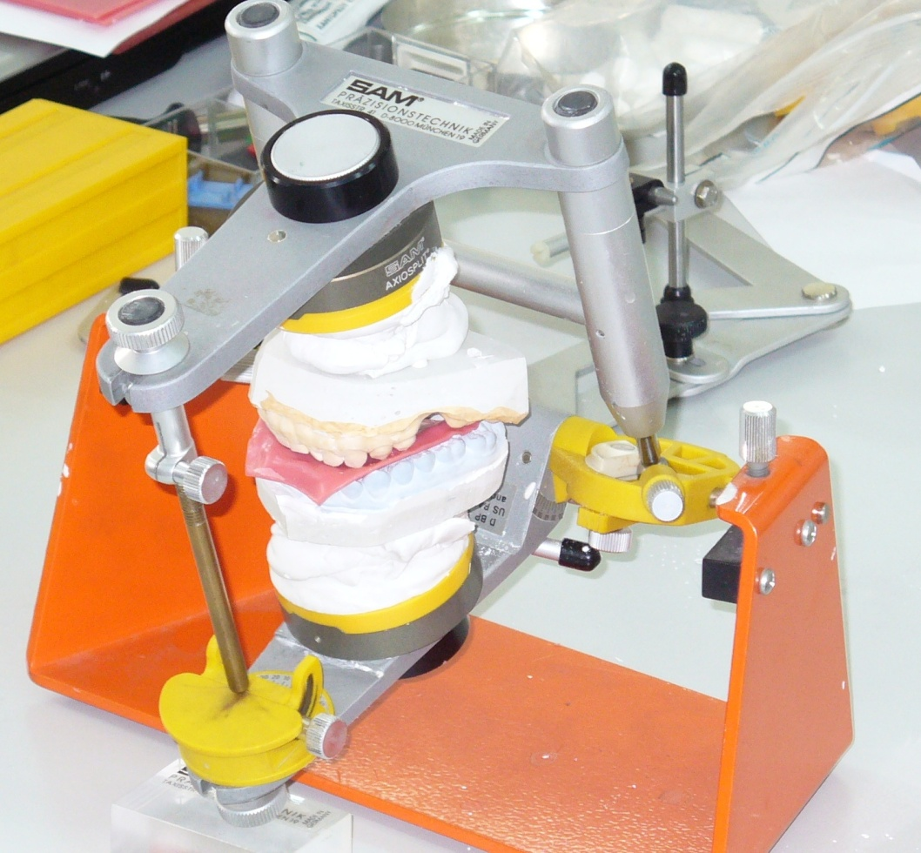
After this paraclinical investigation the patient was diagnosed with myogenous cranio-mandibular dysfunction according to clinical symptoms and other examinations.
Jaw movements were transferred to the SAM articulator and a specific treatment plan was drafted which is about patient education, auto physiotherapy for 6 months and after this period if symptoms are not reduced relaxation splints are indicated.

Slide 12
Conclusions:
Using the CADIAX Compact face-bow and the CADIAX diagnostics system, the coordinate system, defined by the hinge axis point and anterior reference point, is transferred directly to the articulator. Through the mechanical connection between registration and the articulator, CADIAX provides a precise relation for maximum reproducibility.
The CADIAX Compact device is compatible with many types of articulators such as : Artex, Denar, Hanau, Ivoclar, KaVo, Panadent, Reference SL, SAM and WhipMix, so the therapeutic splint positions can be planned and implemented exactly in all spatial directions and also various prosthetic devices are made ​​with high accuracy.
CADIAX Compact is easy to use , the results are reproducible and the system saves following curves, maximum 3 per patient: protrusion, mediotrusion right and left, open/close. This is not only of diagnostic interest, but also serves in ensuring the quality of dental reconstructions.
Electronic axiography has a major role in the differential diagnosis of cranio-mandibular dysfunction of various causes and also offers the clinician the possibility to choose from different therapeutical methods and allows for patient monitoring in time, from the point of view of established treatment.

Slide 13
Bibliography :
Agerberg G., Carlsson G.E.: Symptoms of functional disturbances of masticatory system. A comparision of frequencies in a population sample and in a group of patients. Acta Odontol. Scand., 1975
Biriş C., Popşor S., Luring A.: Ocluzologie, Ed. Universitz Press, Târgu Mureş, 2007
Bumann A., Lotzmann U.: TMJ Disorders and Orofacial Pain (Color Atlas of Dental Medicine)
Cherlea V., Stroe O.: Mic dicţionar de stomatologie englez-român, Ed. Naţional, Bucureşti, 2003
Dawson E.P. : Functional Occlusion - From TMJ to Smile Design, by Mosby, 2007
Okeson J.P.: Management of Temporomandibular Disorders and Occlusion, Sixth Edition, by Mosby
Okeson J.P.: Fundamentals of Occlusion and Temporomandibular Disorders, the C.V. Mosby, St. Louis, Toronto, Princeton, 1985.
Okeson J.P., Adler R.C., Anderson G.C.,Baragona P.v M., Broker E. B., Falace D.A., Graff-Radford S.B., Kaplana S., McDonald J.S., Milliner E.K., Rosenbaum R.S., Seligman D.A.: Orofacial pain. Guidelines for Assessment, Diagnosis and Management. The American Academy of Orofacial Pain. Edited by J.F. Okeson D.M.D. Quintessence Publishing Co. Inc. Chicago, London, Tokyo, Sao-Paulo, Moscow, Prague and Warshaw, 1996
Ieremia L., Totolici D., Iancu A.M., Petrovici D.: Diagnosticul tulburărilor craniomandibulare în medicina dentară, Ed. Univ. “Petru Maior”, Târgu Mureş
Ieremia L., Dodu S. : Necesitatea depistării în scop profilactic a factorilor cauzali disfuncţionali cu repercursiuni asupra biomecanicii elementelor articulaţiei temporo-mandibulare, formei şi rpoartelor spaţiale ale ţesuturilor moi şi dure, Rev. Medicală Târgu Mureş, 1987, XXXIII
Popşor S.: Elemente de gnatologie, UMF Târgu Mureş, 2003
Popşor S., Coman L., Szasz O.: Orientări diagnostice şi terapeutice în disfuncţia craniomandibulară, Ed. Universitz Press, Târgu Mureş, 2002
Reynolds M.D.: Is the concept of temporomandibular joint pain-dysfunction syndrome valid?, 1988
Shore N.A.: Temporomandibular Joint Dysfunction and Occlusal Equilibration, Second Edition, Ed. J.P. Lippincott Co., Philadelphia, Toronto, 1976

Slide 14
Thank you!

