Slide 1
Oral surgery with laser
Laser - OPERCULECTOMY

Slide 2
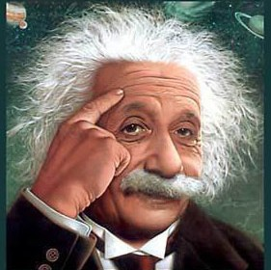
Historical overview
The word laser is an acronym for light amplification by stimulated emission of radiation.
Lasers have been is use in the medical community since the 1970s.
In 1989 the first laser specifically designed for use in dentistry was introduced.
Since then, the number of clinical applications
is constantly increasing.
Laser light is different from ordinary light by being:
- monochromatic (generates a laser beam of
a single color)
- coherent (identical in phisical size and shape)

Slide 3
Laser types in dentistry
LASER | WAVELENGTH (nm) | WAVELENGTH EMISSION | AREAS
Argon (Ar) | 488 | Continuous wave | Soft tissue
Nd(YAG) | 1 064 | Free running pulse emission | Soft tissue
Diode | 800-830/904/980 | Continuous wave Free running pulse emission | Soft tissue
Erbium (Er) | 2 780 – 2 940 | Free running pulse emission | Osseous tissue Enamel Dentin Cementum
CO2 | 10 600 | Continuous wave | Soft tissue

Slide 4
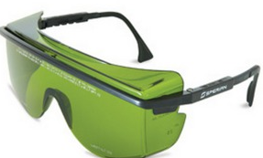
Safety
Lasers can cause eye and skin damage.
Protocol: - wavelength-specific protective eyewear
- minimizing reflective surfaces
- presence of a designated safety officer
- laser mainenance and calibration
- specialized staff
- pacient education

Slide 5
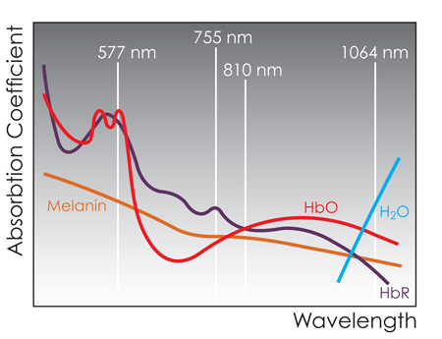
Tissue interaction
Tissue temperatrure increases
Inter- and intracellular water boils away (100 degrees)
Hard tissue expansion and disruption
Soft tissue vaporisation
Continuous exposure to laser energy
tissue CARBONISATION

Slide 6
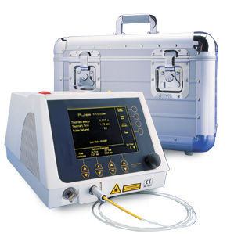
Clinical case
Laser in use : BIOLITEC
Settings : 5 – 7 watts
continuous wave

Slide 7
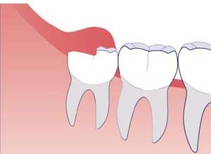

Slide 8
Preoperative view – pericoronal tissue around a partially erupted left third molar.
The laser has been used to make a semilunar incision over the partially erupted tooth.
Excision of the tissue will allow the tooh to completely erupt, with no further treatment needed.

Slide 9
Immediate postoperative view showing a completely exposed third molar.
It has been decided that the molar should not be extracted.
The surgical field is clean and dry.

Slide 10
Two weeks postoperative view showing a completely healed tissue.
The use of lasers accelerates the treatment and decreases the amount of drugs used.

Slide 11
Advantages vs. Disadvantages
High precision
Reduce the amount of bacteria in the surgical site
Hemostasis and no sutures
Reduce swelling and postoperative pain
Less traumatising for the pacient
Promotes cellular healing, leading to faster recovery times
Relatively costly
Extensive training
Lasers are only end cutting; side cutting and shaping cannot be performed with laser

Slide 12
References
1. Gáspár L.: The use of four different lasers in oral soft tissue surgery In: Loh Hong Sai :Lasers in
Dentistry, Monduzzi Editore, Bologna, Italy, 1995.
2. Waidelich,W., Waidelich,R., Hofstetter,A.: Laser in der Medicin
Springer Verlag, Berlin, Heidelberg, 1992.
3. Donald J. Coluzzi,DDS; Robert A. Convissar,DDS:Atlas of laser applications in dentistry, Quintessence Publishing Co, Inc, 2007.
Thank You for Your
attention

